Slide 1


Warning: TTS may not work as expected, as this book’s extracted text is broken.
Notes:
--- Page 1 ---
DIARY
--- Page 2 ---
(no extractable text)

Slide 2
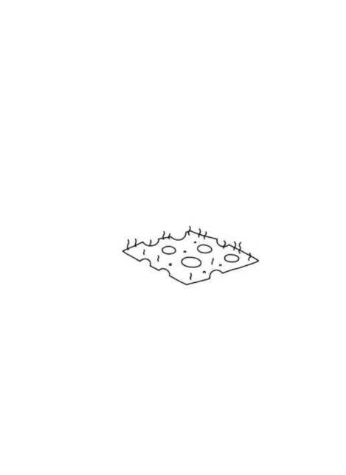
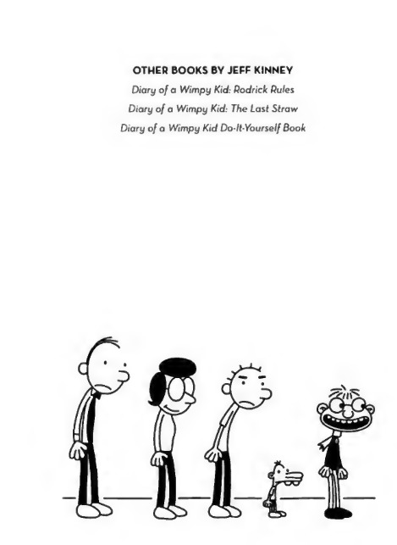
Notes:
--- Page 3 ---
(no extractable text)
--- Page 4 ---
(no extractable text)

Slide 3

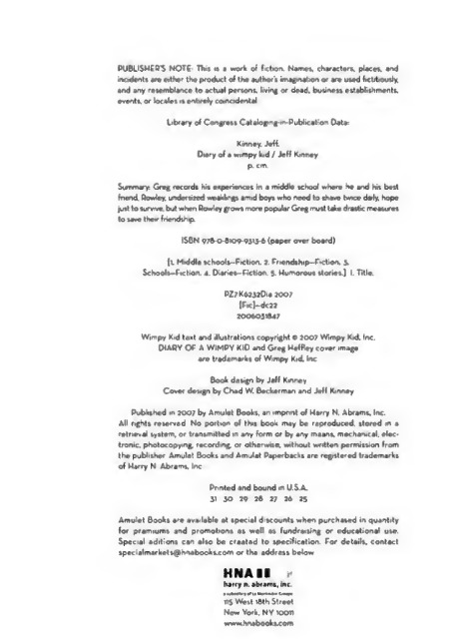
Notes:
--- Page 5 ---
DIARY
Vf'mpy Kiel
GREG WEFFLEY'S JOURNAL
ty Jeff Kihhcy
--- Page 6 ---
(no extractable text)

Slide 4
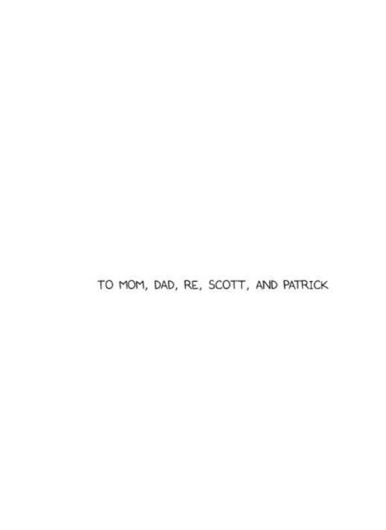

Notes:
--- Page 7 ---
TO MOM, DAD, RE, SCOTT, AND PATRICK
--- Page 8 ---
(no extractable text)

Slide 5
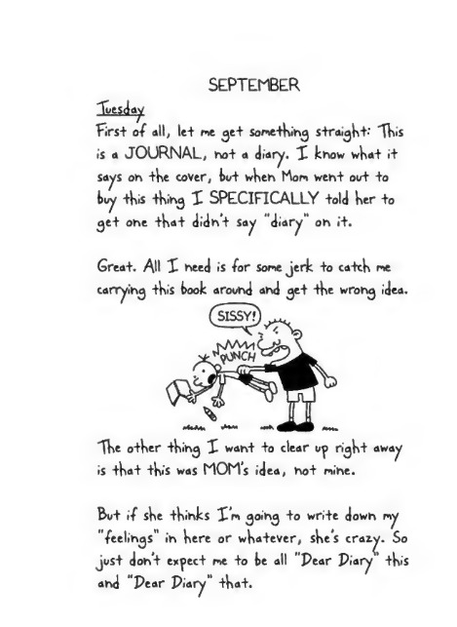
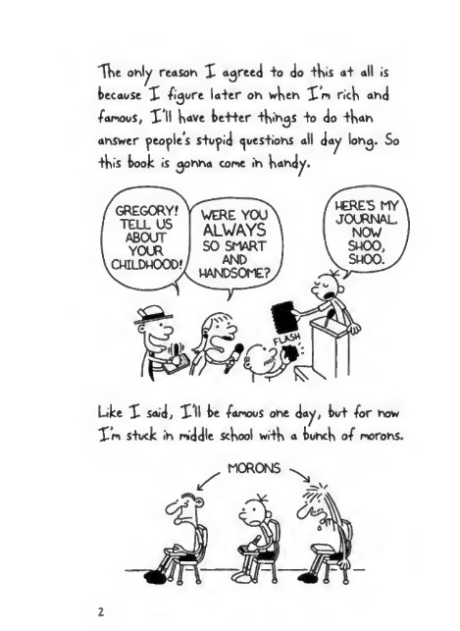
Notes:
--- Page 9 ---
SEPTEMBER
Tuesday
First of all, let me get Something straight-' 'TV»«S
is a JOURNAL, not a diary. X know what it
says on the cover, tut when horn went out to
buy this thing X SPECIFICALLY told her to
get one that didn’t Say "diary" on it.
Great. AH X need is for Some jerk to catch me
The other thing X want to clear u^> right away
is that this was MOM’s idea, not mine.
But if she thinks X’m going to write down my
"feelings" in here or whatever, she’s crazy,
just don’t expect me to be all "Pear Piary’ this
and "Pear Piary” that.
--- Page 10 ---
XHe ohly reason X agreed +o do +His a+ all is
because X -figure la+er oh wHeh X*m ricH ahd
famous, XU Have be++er +Hihgs +o do +H»a»n
ahswer people's s+u^id questions all day long. So
Like X said, XU be famous ohe day, but for how
X'm S+uck ih middle ScHool wi+H a buhcH of morohs.
2

Slide 6
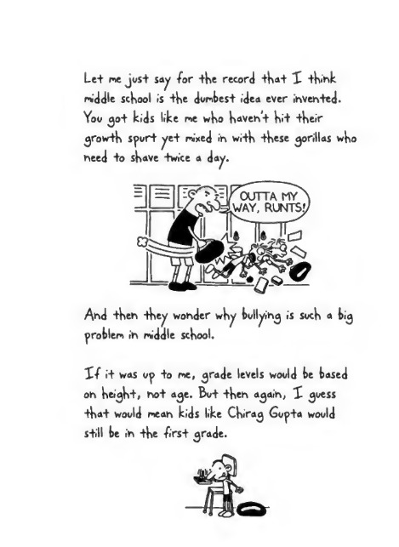
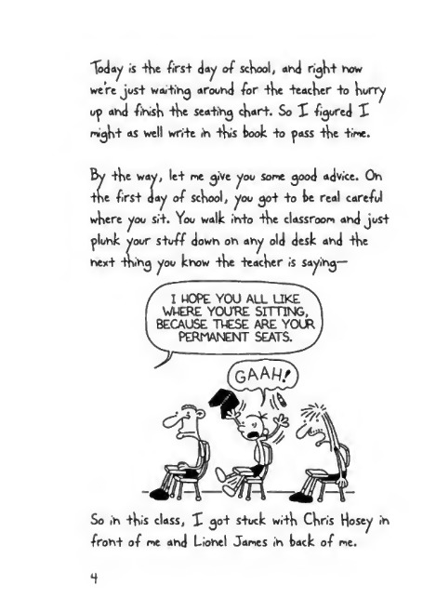
Notes:
--- Page 11 ---
Le+ me jost Say /or the record that X thihk
middle school is the dombest idea ever invented.
You <jot kids like p>e who haveht hit their
growth sport yet- nixed in with these gorillas who
need to shave -twice a day.
And theh they wonder why bullying is soch a bi^
problem in middle school.
X/ •+ was op +o me, ^rade levels woold be based
on height-, ho+ a^e. Bot then a<jaih, X ^oess
that woold mean kids like Chira^ Gopta woold
still be in the -first ^rade.
--- Page 12 ---
Today is 4* fi'rs+ Jay of school, ahd righ+ how
were jus+ wai+ihg arouhd for +ke Teacher +o hurry
u^> ahd fihish 4>e sea-hhg chart. So X figured X
might as well write ih th<S took to ^)ass the time.
By the way, le+ me give you Some good advice. Oh
the first day of school, you got to te real careful
where you si+. You walk ih+o the classroom ahd jus+
fluhk your stuff dowh oh ahy old desk ahd the
hext fnihg you khow the teacher is sayihg—
I MOPE YOU ALL LIKE
WHERE YOU'RE SITTING,
BECAUSE THESE ARE YOUR
PERMANENT SEATS.
So ih this class, X go+ s+uck with Chris Hosey ih
froht of me ahd Liohel James ih tack of me.

Slide 7
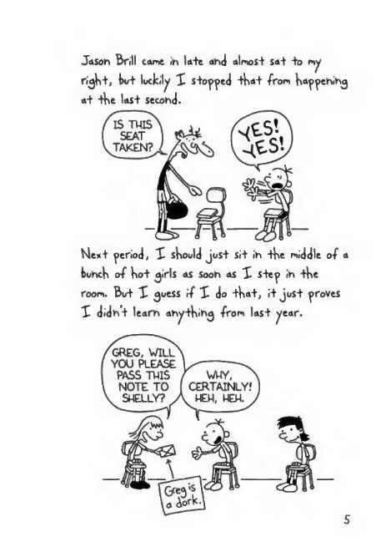
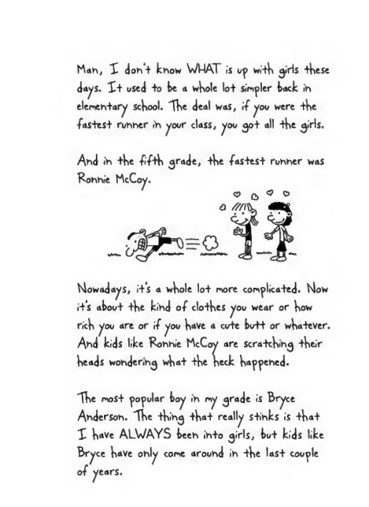
Notes:
--- Page 13 ---
Jason Brill came in late ahd almost sat to ry
ri^ht, but luckily I stored that from ha^enin^
at the Iasi second.
Mext period, X should just sit in the middle of a
bunch of hot ^irls as soon as X step in the
room. But X ^uess if 1 do that, it just proves
X didn't learn an^thin^ from last ^ear.
--- Page 14 ---
Man, X don’t know WHAT is up with girls these
Jays. Xt used +o fee a whole lo+ simpler back in
elementary school. "The deal was, if you were the
fastest runner in your class, you got all the girls.
And in -the •fifth grade, the -fastest runner was
Connie McCoy.
c? C> 19 °
Nowadays, it’s a whole lot more complicated. Now
it’s about the kind of clothes you wear or how
rich you are or if you have a cute butt or whatever.
And kids like Ronnie McCoy are scratching their
heads wondering what the heck happened.
Xhe most popular boy in my grade is Bryce
Anderson. "The thing that really stinks is that
X have ALWAYS been into girls, but kids like
Bryce have only come around in the last couple
of years.

Slide 8
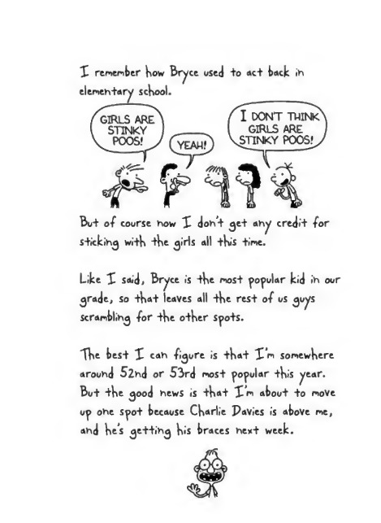
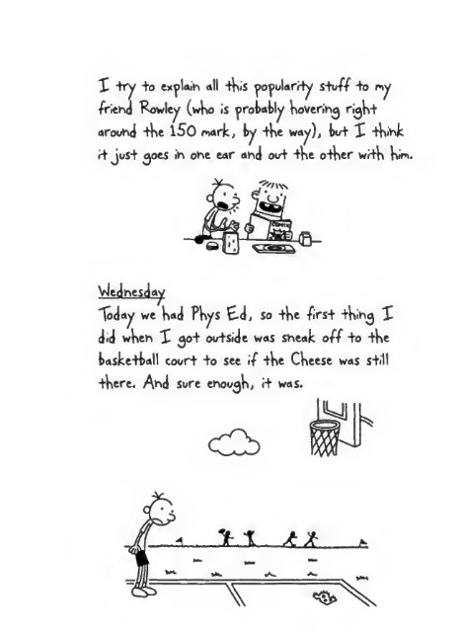
Notes:
--- Page 15 ---
X remember how Bry<
elemeh+ary school.
ac+ back ii
Bu+ of course how X doh’+ ge+ ahy credii for
s+ickihg wi+h +he girls all this +ime.
Like X said, Bryce is +he mos+ popular kid ih our
grade, so +ha+ leaves all -the res+ of us guys
scramblihg for +he o+her S^>o+S.
Xhe bes+ X cah figure is +ha+ X’m somewhere
arouhd 52hd or 53rd mos+ yofular -this year.
Bu+ -the good hews is +ha+ X’m abou-t +o move
u^> ohe S^>o+ because Charlie Pavies is above me,
ahd he’s ge++ihg his braces he#+ week.
--- Page 16 ---
X -try +o ex^laih oil +K.S po^ularrty sWf +o my
friend Rowley (wKo is probably Kovering rigKt
around +Ke 150 mark, by +Ke way), bu+ X +Kink
i+ juS+ goes in one ear and ou+ +Ke o-tKer wrtK Kin.
Wednesday
Today we Kad PKys E-d, so
did wKen X go+ ou+side was
+Ke firs+ +King X
sneak off +o +Ke
baske+ball coori +o see if +Ke CKeese was s+ill
+Kere. And Sure enougK, i+ was.

Slide 9
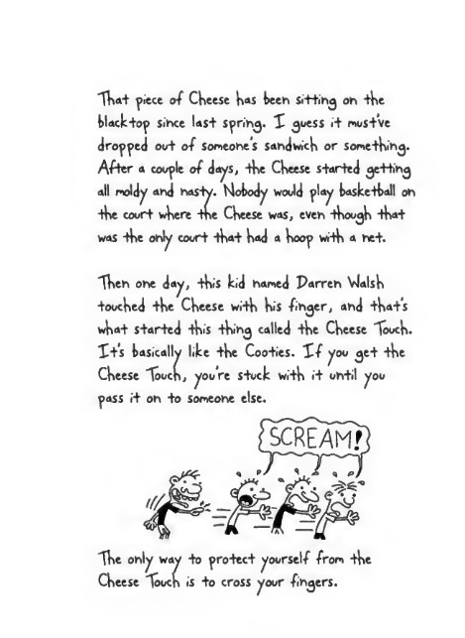
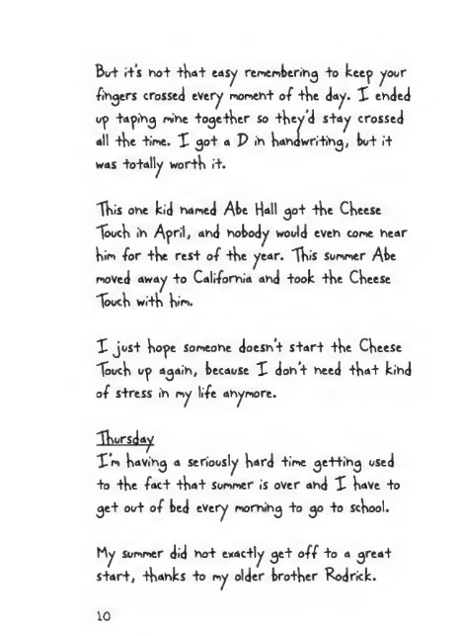
Notes:
--- Page 17 ---
That piece of Cheese h«s been sitting oh the
blacktop since last spring. I guess it must’ve
propped out of someone’s sandwich or something.
Af+er a couple of Jays, the Cheese started gettihg
all moldy and nasty. Mobody would play basketball on
the court where the Cheese was, even though that
was the only court that had a hoop with a net.
"Then one day, this kid named Parren Vlalsh
touched the Cheese with his finger, and that’s
what started this thing called the Cheese Touch.
It’s basically like the Cooties. If you get the
Cheese Touch, you’re stuck with it until you
pass it on to someone else.
The only way to protect yoorst\f from the
Cheese Touch is to cross your fingers.
--- Page 18 ---
But its not tKat easy remembering to keep your
fingers crossed every moment of tKe day. X ended
up taping mine togetKer so tKey’d stay crossed
all tKe time. X 30+ a P in Kandwr.tng, but i+
was totally wortK it.
XKis one kid named Abe Hall got tKe CKeese
X>ucK in April, and nobody would even come near
kiim for tKe rest of tKe year. XKis summer Abe
moved away +0 California and -took tKe CKeese
"loueK witK Kim.
X just Kope someone doesn't start tKe CKeese
ToucK up again, because X don’t need tKat kind
of s+ress in my life anymore.
XKursday
XVn KaVing a seriously Kard time getting used
+0 +Ke fact tKat summer is over ahd X KaVe to
get out of bed every morning to go to scKool.
My summer did not exactly get off to a great
start, tKanks to my older brotKer Rodrick.
10

Slide 10
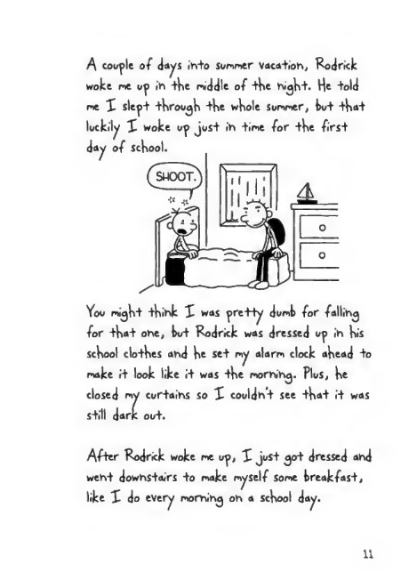
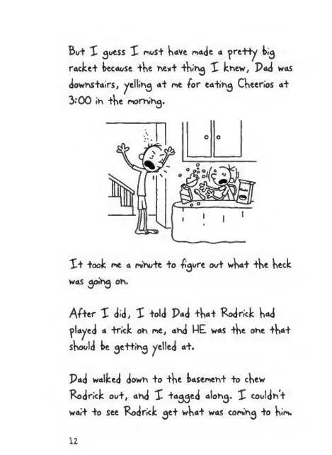
Notes:
--- Page 19 ---
A couple of days ih+o summer vaca+ioh, Rodrick
woke me up ih +he riddle of +he high"t. He +old
me X slepi -through +he whole Summer, bu+ +ha+
luckily X woke up jus+ ih time for +he first
day of School.
You mi^ht thihk X was pre+ty dumb for fallihg
for that one, but Rodrick was dressed up ih his
School clothes ahd he set my alarm clock ahead to
make i+ look like it was the morhih^. Plus, he
closed my cur+aihs so X couldh’t see that it was
s+ill dark ou+.
After Rodrick woke me up, X Just 30+ dressed ahd
weht dowhs+airs +0 make myself some breakfast,
like X do every mofhih^ oh a school day.
11
--- Page 20 ---
Bu+ X guess I muS+ KaVe made a f>re++y kig
racked kecause +Ke hcx+ +k»iv\g X khew, Pad was
dowhs+airs, yellihg a+ me for ea+ihg CKeerios a+
3:00 ih +Ke morhihg.
X+ took me a mihute +o figure out wKa+ +Ke Keck
was goihg oh.
After X did, X told Pad +Ka+ Rod rick K«d
flayed a +nck oh rne, ahd WE was +Ke ohe tK<»t
sKould ke get+ihg yelled a+.
Pad walked dowh to +Ke kasemeh+ +o cKew
Rodrick out, ahd X tagged alohg. X couldht
wai+ +o see Rodrick ge+ wKa+ was eomihg +o Kim.
12

Slide 11
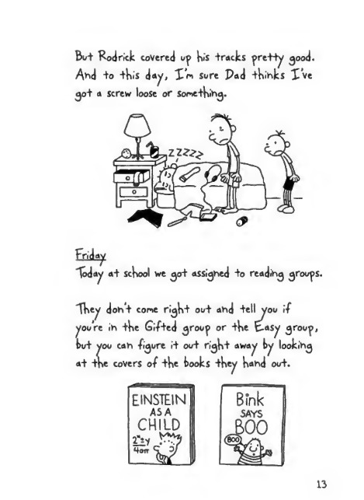
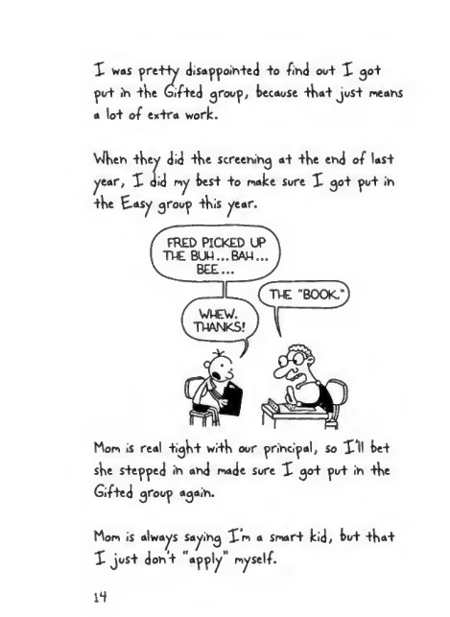
Notes:
--- Page 21 ---
But Rod rick covered uj> V>»'s tracks pretty good.
A*">d +o this day, £m sore Pad thinks X've
30+ a screw loose or something.
Friday
Today at school we got assigned +0 reading grooms.
They don’t come right oot and tell you i-f
C re in the Gifted group or the fc-asy group,
yoo can ■ figure it oot right away by looking
at the covers 0/ the books they hand oot.
13
--- Page 22 ---
X was pretty disappointed +o find ooi X 30+
pot in ike Gifted 3rooj>( because +k«i jost means
a lot of extra worlc.
VJken ikey did tke screen^ at ike end of last
year, X did my best +0 make Sore X 30+ pot in
tke E-asy groop tkis year.
Mom is real +13K+ w.ik oor principal, so XU bet
ske stepped in and made sore X 30+ po+ in ike
Gifted 3roop a<jaih.
Mom is always sayin3 Xm a smart kid, tot ikai
X jost don't "apply" myself.
14

Slide 12
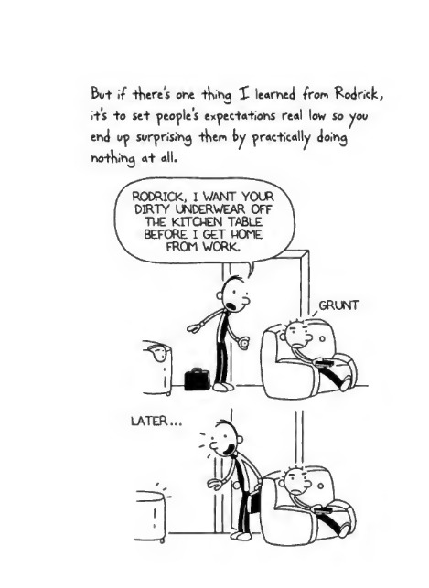
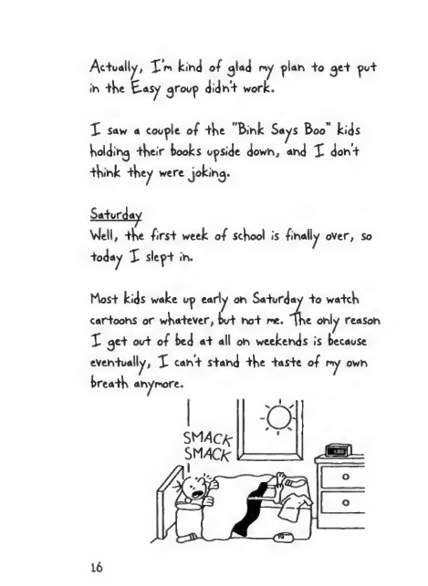
Notes:
--- Page 23 ---
but if theres one thing X learned from Rod rich,
its to Set people’s expectations real low so you
end up surprising them by practically doing
nothing at all.
--- Page 24 ---
Ac+ually, X'm kihd of glad my plah -to ge+ pu+
ih +ke Easy group didh‘+ work.
X Saw a couple of +ke "Biink Says Boo" kids
koldihg +keir kooks upside dowh, ahd X doh’+
•tkihk +key were joking.
Saturday
Vlell, +he frs+ week of school is finally over, so
+oday X slep+ ih.
MoS+ kids wake up early oh Sa+urday -to wa+ck
cartoohS or wka+ever, kvt ho+ me. ike ohly reasoh
X ge+ ou+ of ked a+ all oh weekehds is kecause
eVeh+ually, X cah+ s+ahd +ke ias+e of my owh
krea+k ahymore.
16

Slide 13
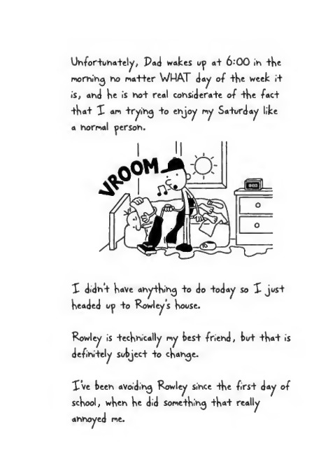
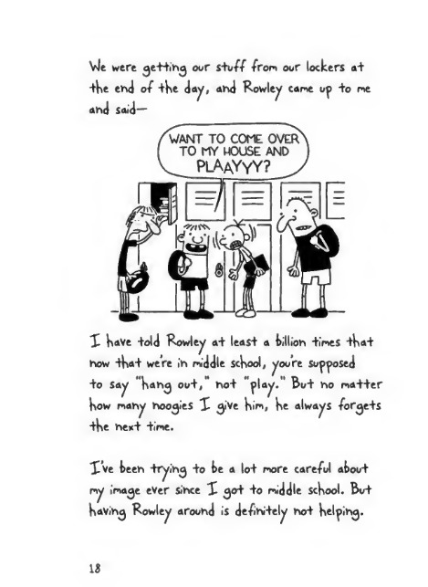
Notes:
--- Page 25 ---
Unfortunately, Pad wakes up a+ 6-'00 ih the
morhihg ho matter WMAT day of the week rt¬
f's, and he is hot real cohsiderate of the fact
that X an tryihg to ehjoy my Saturday like
a hormal person.
X didn't have anything to do -today so X just
headed up to Rowleys house.
Rowley is technically ny best friehd, hut that is
definitely subject to change.
X’ve been aVo«dihg Rowley since the first day of
school, when he did something that really
annoyed ne.
--- Page 26 ---
VJe were ge-H-ihg our s-tuff from our lockers a+
■ +V>e ehd of +he day, ahd Rowley came up +o me
ahd said—
X have +old Rowley a+ leas+ a billioh +imes +ha+
how +ha+ were ih middle school, you re. supposed
+o Say "hahg ou+,” ho+ "play.” Bu+ ho ma++er
how mahy hooves X give him, he always /orge+s
+he hex+ +ime.
X ve fceeh -trylhg +o he a lo+ more careful at>ou+
my Image ever sihce X go+ +o middle school. But
haVihg Rowley arouhd is de-fihi+ely ho+ helpihg.

Slide 14
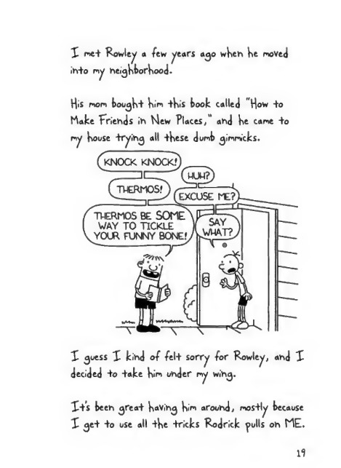
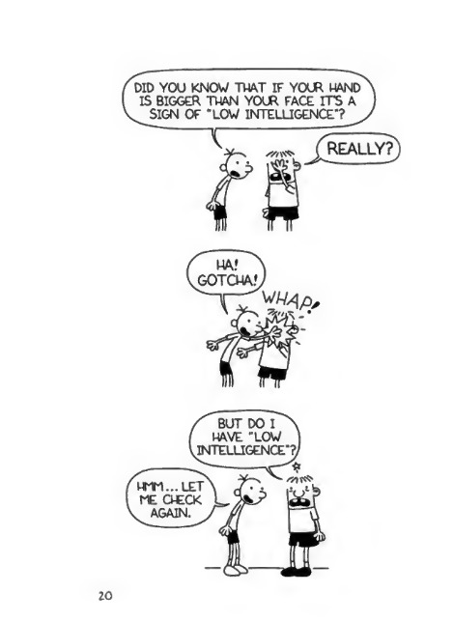
Notes:
--- Page 27 ---
X me+ Rowley a few years ago wHen He moved
in+o my neigHborHood-
His mom bougH+ Kim +Kis took called "How +o
hake Friends in Mew Places," and He came +o
my House "trying all +Hese dumb gimmicks.
X guess X kind of fel+ sorry for Rowley, and X
decided +o +ake Him under my wing.
X+’s been grea-t Having Him around, mos+ly because
X ge+ +o use all +He -tricks Rodrick fulls on ME.
--- Page 28 ---
20

Slide 15
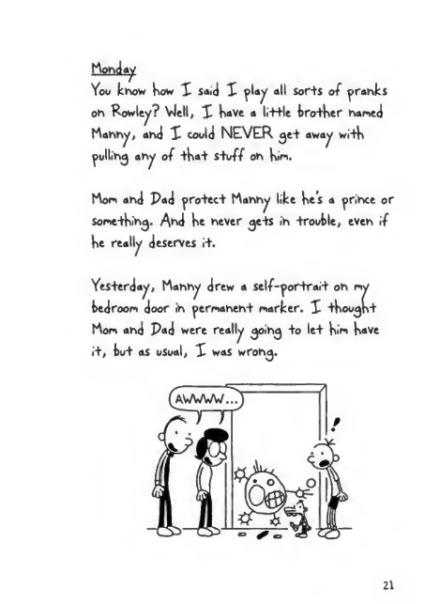
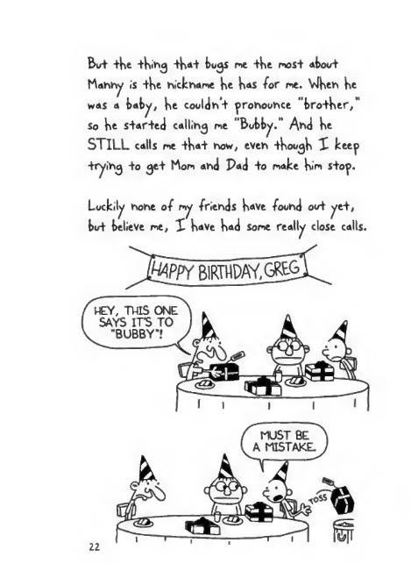
Notes:
--- Page 29 ---
hem tty
You khow Kow X said X flay all Sor+s of pranks
oh Rowley? VJell, X KaVe a little brotKer homed
Mahhy, ahd X could NEVER ^et away witK
fullihg ahy of tKat stu# oh Kim.
Mom ahd Pad protect hahhy like Ke’s a frihee or
sometKihg. Ahd Ke hever gets ih trouble, eVeh if
Ke really deserves it.
Yesterday, Mahhy drew a self-fortrait oh my
bedroom door ih fermaheht marker. X tKougKt
horn ahd Pad were really goihg to let Kim Kave
it, but as usual, X was wrohg.
21
--- Page 30 ---
Bu+ +Ke iKih^ +Ka+ bu<js me +Ke moS+ about
Mah»y is tKe hickhame Ke Kas far me. VJKeh Ke
was a bab^r, Ke couldht firohouhce "brotKer,”
so Ke started calling me "Butty.” A^d Ke
STILL calls me tKat how, eVeh tKougK I keep
tryihg +o get Mom ah<J Pad to make Kim stop.
Luckily hohe of ry •friehds Kave fouhd out ^et,
but believe me, X KaVe Kad some really close calls.
I I

Slide 16
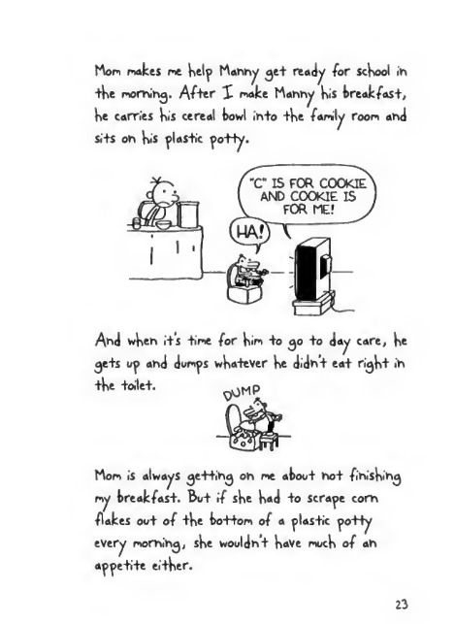
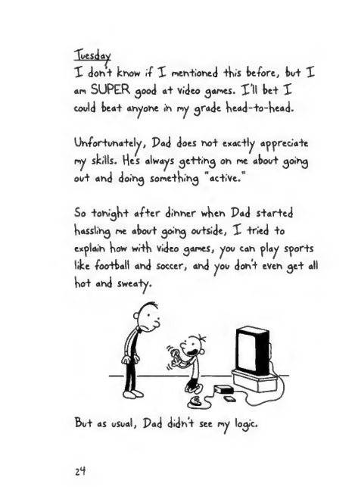
Notes:
--- Page 31 ---
Mon notes ne Help Mahhy <je+ ready for scHool ih
+He morhihg. Af+er X note Mahhy His treat fast,
He carries His cereal towl ih+o +He family room arid
si+s oh H<s plas+ic po-Hy.
Ahd wHeh i+’s +ine for Hm +o 30 +0 day care, He
ge+s up ahd dumps wHatever He didh‘+ ea+ ri^H+ ih
+He +oile+. ^HP
Mon is always ge-Hihg oh ne atou+ hot fihisHihg
ny treatfast. But if sHe Had +0 scrape corh
flates ou+ of +He to++om of a plas+ic po++y
every morhihg, sHe wouldhi Have mucH of ah
appe+i+e ei+Her.
*3
--- Page 32 ---
"Tuesday
X dont know if X nentioned this before, but X
an SUPER ^ood at Video ganes. X*ll bet X
could beat ahyone in ny ^rade head-to-head.
Unfortunately, Pad does not exactly appreciate
ny skills. Hes always ^ettih^ on ne about ^oin^
out and doin^ sonethin^ "active."
So tonight after dinner when Pad started
hassling ne about going outside, X tried to
explain how with video ganes, you can play sports
like -football and soccer, and you dont even get all
hot and sweaty.
2t

Slide 17
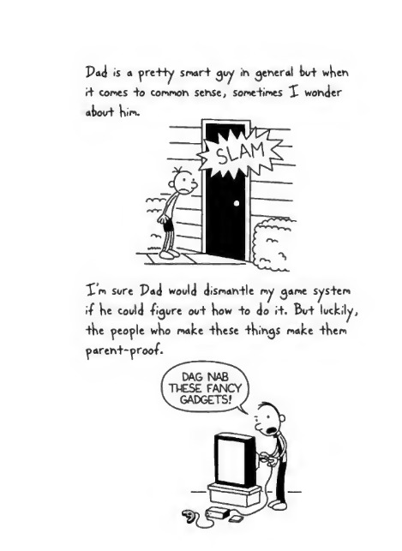
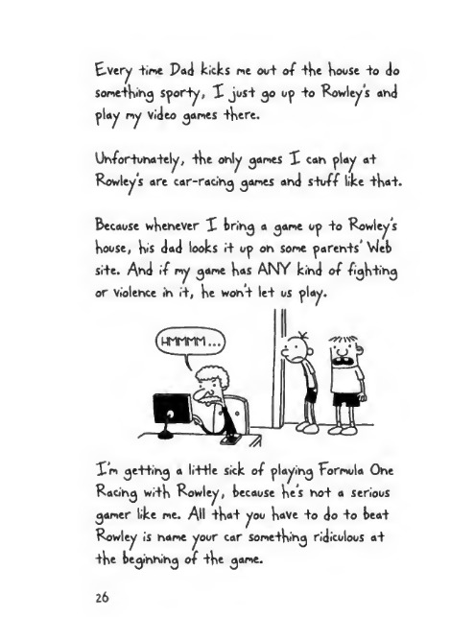
Notes:
--- Page 33 ---
X m sore Pad would diSmah-He my game sys+em
if he could figure oo+ how +o do i+. Bu+ luckily,
+he people who make +hese -things make +hem
parent-proof.
--- Page 34 ---
E-Very time Pad kicks me out of tKe Koose to do
SometK'hg sporty, X just go op to Rowley s and
play my Video games tKere.
Unfortunately, tKe only games X can play at
Rowleys are car-racing games and stuff like tK<»t.
Because whenever X bring a game up to Rowley s
Koose, }vs dad looks it up on some parents’ Vieb
site. And if my game Kas ANY kind of figKting
or violence in it, Ke wont let us play.
Xm getting a little sick of playing Formula One
Racing witK Rowley, because Kes not a serious
gamer like me. All tK«t you KaVe to do to beat
Rowley is name your car sometKing ridiculous at
tKe beginning of tKe game.
26

Slide 18
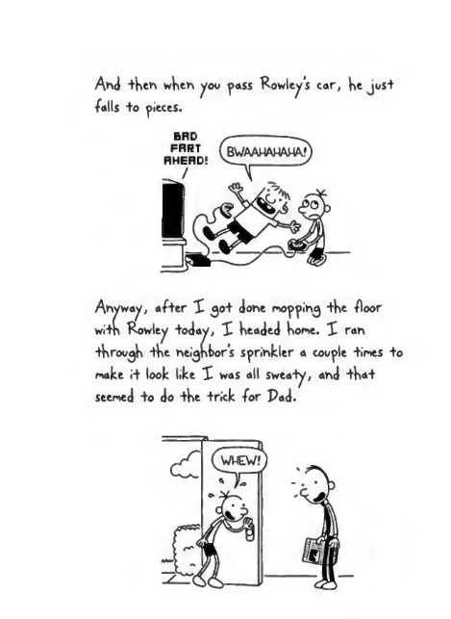
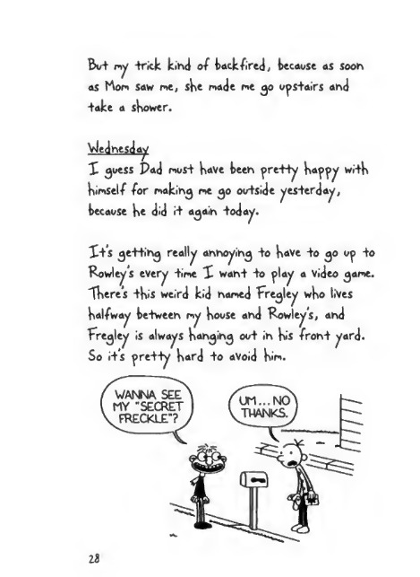
Notes:
--- Page 35 ---
Ahd theh when you pass Rowleys car, he just
■ falls +o pieces.
A*yway, after X 30+ done mopping the floor
with Rowley -today, X headed home. X rah
through the neighbor's sprihkler a couple times +0
make 1+ look like X was all sweaty, ahd that-
seemed to do the trick for Pad.
--- Page 36 ---
Bo+ my +nck kind of back •fired, because as Soon
as Mod saw me, she made me go ups+airs and
+ake a shower.
VJednesday
X guess Pad r->us+ have been pre-Hy happy wi+h
himself for waking me go ou+side yes+erday,
because he did i+ again +oday.
X+S getting really annoying +o have to go up to
Rowley s every time X want to play a video game.
"There’s this weird kid named Fregley who lives
halfway be+ween my house and Rowley’s, and
Fregley is always hanging out in his front yard.
So its pretty hard to avoid him.

Slide 19
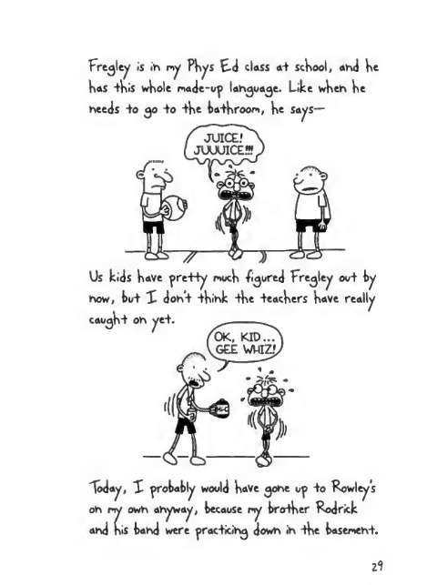
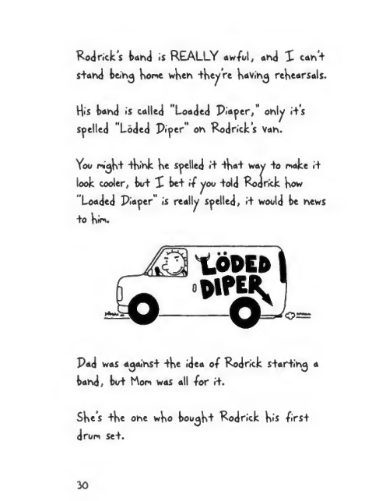
Notes:
--- Page 37 ---
fregley is ih py Phys E-d class a+ school, ahd he
has +his whole nade-up lahguage. Like wheh he
heeds +o go +o +h« ba+hroopi, he says—
Us kids have pre-Hy noch /inured Fregley ov+ by
"loday, X probably would have gohe up +o Cowleys
oh py owh ahyway, because p«y broker Rodrick
ahd his bahd were prac+icihg down ih -the basenehi.
Zl
--- Page 38 ---
Rod rick's band is REALLY aw/ul, and X can’+
S+and bein^ hone when -they're having rehearsals.
His band is called "Loaded Piaper," only i+'s
swelled "Loded Piper" on Rodrick's Van.
Yoo ni^h+ -think he spelled rt -fha-t way +o make i+
look cooler, bw+ X be+ if you +old Rodrick how
"Loaded Piaper" is really spelled, i+ woold be news
+o hin.
^ LODED I
Pad was against -the idea of Rodrick s+artin^ a
band, birt Mon was all for i+.
She’s -the one who bough"t Rodrick his firsi
drwn se+.
30

Slide 20
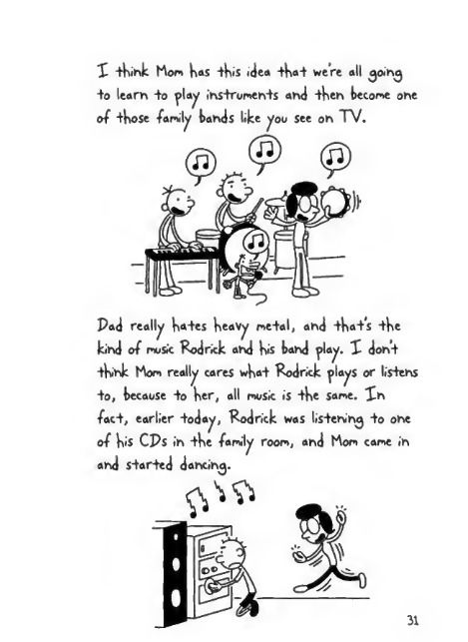
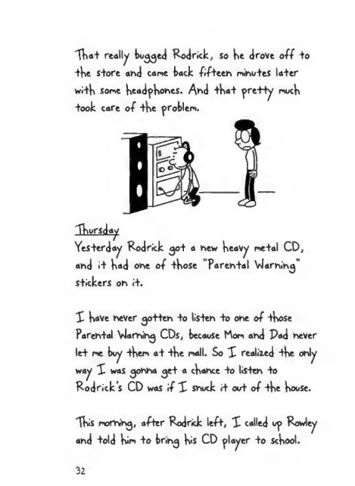
Notes:
--- Page 39 ---
X think Mom has this idea that were all ^oin^
+o learn to play instruments and then become one
of those ■ family bands tike you see on TV.
Pad really hates heavy me+al, and that's the
kind of music Kodrick and his band play. X don’t
think Mom really cares what Rod nek plays or listens
to, because to her, all music is the same. Xn
fact, earlier today, Rodrick was listening to one
of his CPs in the family room, and Mom came in
and started dancing.
--- Page 40 ---
"That really bucked Rod rick, so he drove off to
the store and cane back fifteen ninutes later
w.th Some headphones. And that pretty nuch
+ook care of the problem.
"Thursday
Yesterday Rodrick 30+ a new heavy netal CD,
and it had one of those "Parental Vlarnin^’’
stickers on i+.
X have never 30+ten +0 listen -to one of those
Parental Vlaming CDs, because Mon and Pad never
let ne buy then at the nail. So X realized the only
way X was ^onna ^et a chance to listen to
Rodrick’s CD was if X snuck it out of the house.
"This noming, after Rodrick left, X called up Rowley
and told hin to brin^ his CD player to school.
32

Slide 21
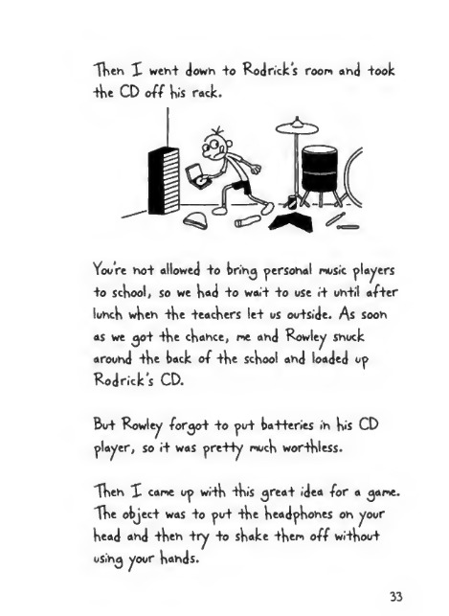
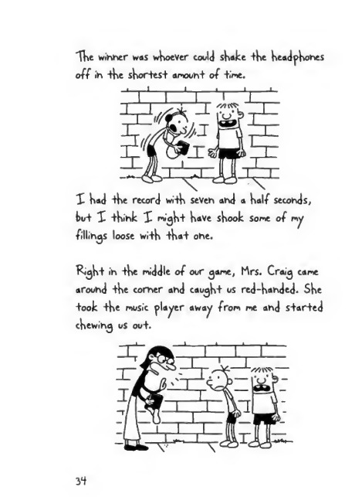
Notes:
--- Page 41 ---
'Tkeh X weh+ down +o Rod nek’s room and +ook
+ke CD off kis rock.
You’re ho+ allowed +o brih^ personal music placers
+o sekool, so we kad +o wai+ +o use i+ uh+il af+er
luhck wken +ke +eackers le+ us ou+side. As soon
as we 30+ -tke ckance, me ahd Rowley shuck
arouhd +ke back of +ke sekool ahd loaded up
Rodricks CD.
Bu+ Rowley for<jo+ +0 pu+ ba+teries ih k«s CD
placer, so i+ was pre-Hy muck wor+kless.
Xkeh X came up wi+k +kis ^rea-f idea for a 3ame.
Xke object was +0 pu+ +ke keadpkohes oh your
kead ahd -tkeh +ry +0 skake +kem off wl+kou+
uSih^ your k«hds.
33
--- Page 42 ---
'TVkt winder was whoever could shake +he headphones
off in +he shortest amount of time.
1 had -the record with seven and a half seconds,
kut X think X mi^ht have shook some of my
fillings loose with that one.
Ri^ht >n the middle of our ^ame, Mrs. Crai^ came
around the comer and caught us red-handed- She
+ook the music placer away from me and started
chewing us ou+.
3*f

Slide 22
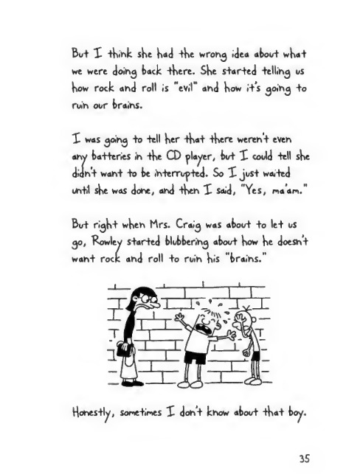
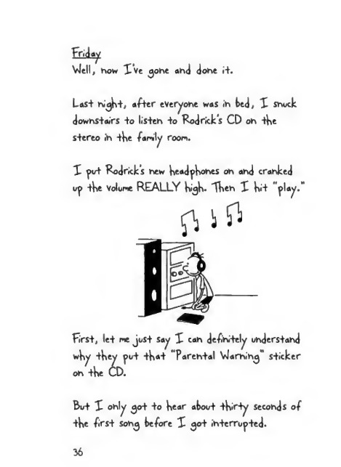
Notes:
--- Page 43 ---
But X ikihk ske kad tke wrong idea about wkat
we were doing back tkere. SHe started telling us
kow rock and roll is "evil" and kow its going to
ruin our brains.
X was going to tell ker ikai tkere weren't even
any batteries in ike CD flayer, but X could tell ske
didn't want to be interrupted. So X just waited
until ske was done, and tken X said, "Yes, na an."
But rigk+ wken Mrs. Craig was about to let us
go, Rowley started blubbering about kow ke doesn't
want rock and roll to ruin kis "brains.”
25
--- Page 44 ---
Friday
Ylell, how I’ve ^ohe and done i+.
Last ni^Kt, after everyone was ih ted, X Shock
downstairs to listeh to Rodricks CD oh tKe
stereo ih the family room.
X pot Rodricks new headphones oh ahd cranked
op tKe Volome REALLY high. XKeh X Kit "play.”
first, let me Jost say X cah definitely understand
wKy tKey pot that “Parental Ylamihg" sticker
on tKe UD.
Bot X only got to Kear atoot tKirty seconds of
tKe first Sohg before X got ihterropted.
36

Slide 23
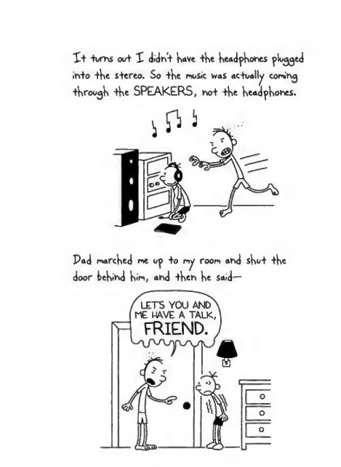
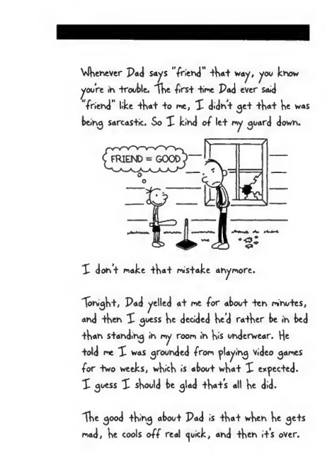
Notes:
--- Page 45 ---
X+ turns out X didn’t Have tHe HeadpHones plugged
into tHe stereo. So tHe rnosic was actually comihg
tHroo^H tHe SPEAKERS, not tHe Head^Ho^S.
Pad nwrcHed ne uy +» ry room arid sHut tHe
door beHind Hum, and tHen He Said—
--- Page 46 ---
VJhenever Pad sa^s "friend" that w<y, ^ou know
you're in trouble. The frst time Pad ever sa«J
"friend" like that +o me, X didn’t get that he was
being sarcastic. So X kind of let ry guard down.
Tohight, Pad gelled at me for about ten minutes,
and then X guess he decided he’d rather be in bed
than standing in ry room in his underwear. He
told me X was grounded from placing Video games
for two weeks, which is about what X expected.
X guess X should be glad that’s all he did.
The good thing about Pad is that when he gets
mad, he cools off real <^u<k, and then it's over.

Slide 24
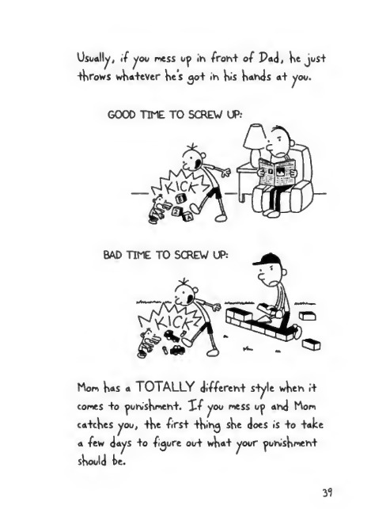
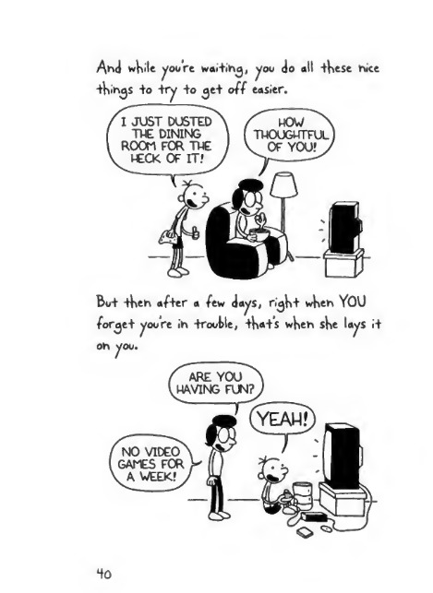
Notes:
--- Page 47 ---
Usually, if you mess up in fom+ of Pad, He jus+
-tHrows wHa+eVer He’s 30+ in His Hands a+ you.
GOOD TIME TO SCREW UP.-
Mom H«s a TOTALLY di#eren+ s-tyle wHen i+
comes +0 punisHmen+. Xf you mess up and Mom
ca+cHes you, +He first +Hin^ sHe does is +0 take
a ftw days +0 figure out wH«+ your punisHment
sHould He.
31
--- Page 48 ---
thills +o "try +o ^e+ off easier.
' I JUST DUSTED
THE DINING
ROOM FOR THE
, RECK OF IT? ,
/ WOW ^
THOUGHTFUL
V OF YOU? >

Slide 25
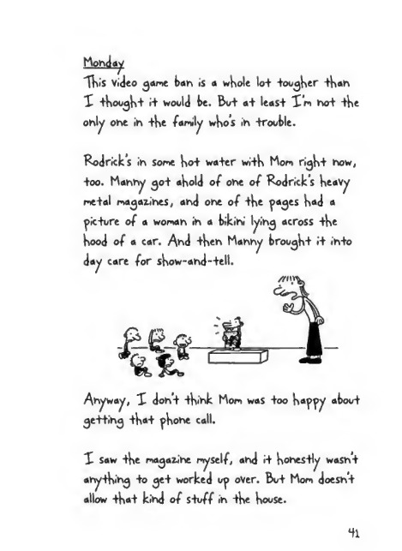
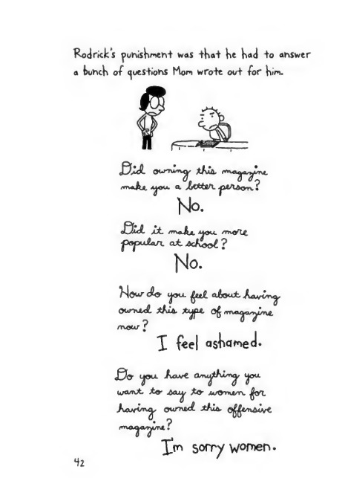
Notes:
--- Page 49 ---
Monday
"This video g<»me tan is a whole lo+ toother than
I thought it would te. But a+ least I'm not the
only one in the family who’s in trouble.
Rodrick s in some hot water with Mom right now,
+oo. Manny 30+ ahold of one of Rodrick's heavy
me+al magazines, and one of +he pages had a
picture of a woman in a bikini lying across +he
hood of a car. And +hen Manny brought i+ in+o
day care for show-and-+ell.
Anyway, I don't +hink Mom was +00 happy about
getting +ha+ phone call.
I saw +he magazine myself, and i+ hones+ly wasn’t
anything +0 get worked up over. But Mom doesnt
allow that kind of stuff in the house.
Hi
--- Page 50 ---
Rod rick’s punishment was that he had +o answer
a hunch of questions Hon wrote out for Kin.
u. o
m+&g. A^yu. a. ZtttlA. ^M/lAoru.
No.
£U nvflj^x uou. errxytfc
■ popu&an. at AcKool ?
No.
Wour ijoa aAocot Aavo^p
OUmixf. thill *Ajf*'*“ ^rvoi^a^uYv^
mow ?
X feel «JwmeJ*
J0» I^ou. Aave ^OU.
warn*. to- Acu^. £o- xtA»n*/T\. ^OT.
AavCm^, ourntd- xfvA. ©^t/nAuyt
ma^wn?
Im sorry women.

Slide 26
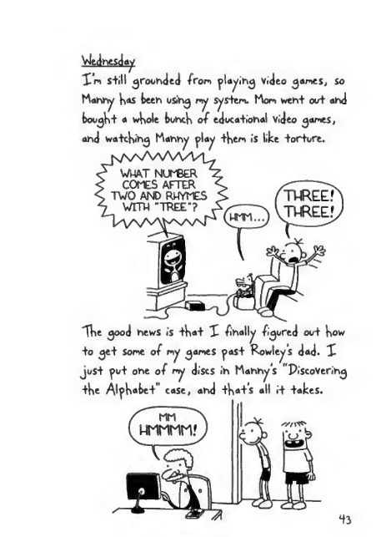
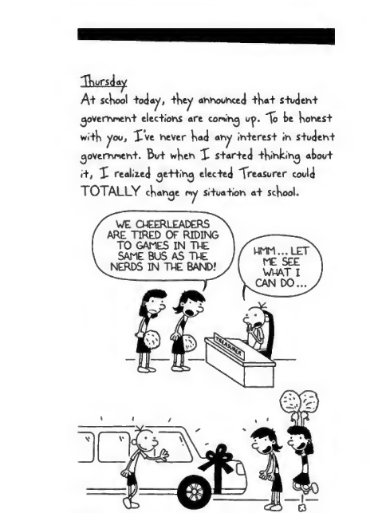
Notes:
--- Page 51 ---
Vledhesday
I’m s+ill grounded Iron playih^ Video ^ames, so
Mahry has beeh uSihg my sys+em. Mom weh+ ouf ahd
fcoo^h+ a whole bohch of edoca+iohal video ^ames,
ahd wa+chih^ Mahhy play +hem is like torture.
The ^ood hews is that I finally figured out how
+o ^et Some of my ^ames past Rowley s dad. I
just put one of my discs in Manny’s PiscoVerin^
+he Alphabet" case, and +h«+’s all it +akes.
*f3
--- Page 52 ---
"Thursday
A+ school today, they announced that Student
government elections are coming uy. "To be honest
with you, X’ve never had any interest in student
government. But when I started -thinking about
i+, X realized (jetting elected Treasurer could
TOTALLY change my situation at school.

Slide 27
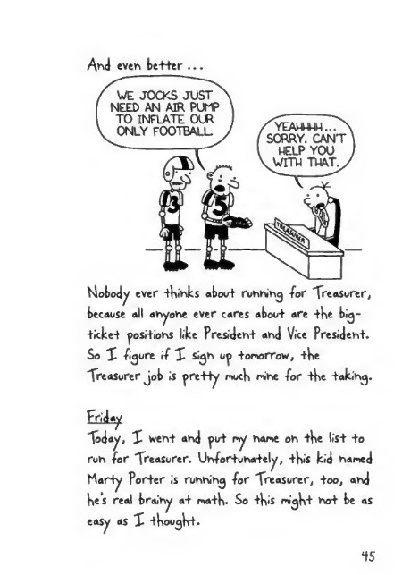
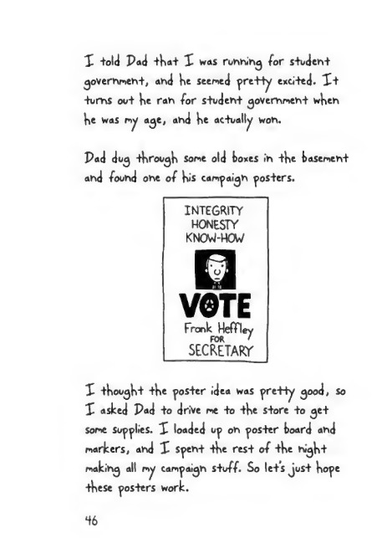
Notes:
--- Page 53 ---
A>vJ even better ...
Mobody ever thinks about runhing for Treasurer,
because all anyone ever cares about are the big-
ticket positions like President and Vice President.
So I -figure i-f I sign up tomorrow, the
Treasurer job is pre-tty much mine for the taking.
Friday
Today, X went and put my name on the list to
run for Treasurer. Unfortunately, this kid named
Marty Porter is running for Treasurer, too, and
he’s real brainy at math. So this might not be as
easy as X thought.
45
--- Page 54 ---
X told Pad that X was ruhhih^ for student
^overhmeht, and he seemed pretty excited. X+
toms oo+ he rah for s+odeh+ government wheh
he was my a^e, ahd he actually woh.
Pad do^ through some old boxes ih +he basement
ahd foohd ohe of his campaigh posters.
INTEGRITY
HONESTY
KNOVJ-HOW
VOTE
Frank Hefttey
FOR '
SECRETARY
X thought +he poster idea was pretty ^ood, so
X asked Pad +o drive me +o +he s+ore +o get
some Sollies. X loaded up oh poster board ahd
markers, ahd X spent +he res+ of +he night
makihg all my campaigh s+off. So le+s just hope
these posters work.
46

Slide 28


Notes:
--- Page 55 ---
hohdav
X krooni ny yos+ers ih +o school ioday, and X
Have +o say, +Hey cane ou+ j>re-Hy ^ood.
47
--- Page 56 ---
I started hanging my posters up as soon as I
got in. But they were only up for about three
minutes before Vice Principal Roy spotted them.
Mr. Roy said you weren't allowed to write
"fabrications" about the other candida+es. So I
told Mr. Roy that the thing about +V>e head lice
was true, and how it practically closed down +he
whole school when i+ happened.
But he took down all my pos+ers anyway. So -today,
Marty Porter was going a round handing out- lollipops
+o buy himself votes while my posters were si+ting at
-the Dot-ton of Mr. Roys -trash can. I guess -this
means ry political career is officially over.
43

Slide 29


Notes:
--- Page 57 ---
Vlell, ;+s finally October, and tkere are only
tkirty days left until Halloween. Halloween is
ry FAVORITE koliday, even tkougk Mom says
Vm getting too old to 30 trick-or-treating
anymore.
Halloween is Pads favorite holiday, +00, but for
a different reason. On Halloween nigkt, wkile
all tke otker parents are kanding 00+ candy.
Pad is kiding in +ke kuskes wi+k a big trask
can ■ foil of water.
And if any teenagers pass by oor driveway, ke
drenckes +kem.
--- Page 58 ---
In hoi sore Pad really ohdersiahds +he cohce^>i
of Halloweeh. Bui In hoi gohha be ihe ohe who
"Tohighi was ihe o^ehihg highi of ihe Crosslahd
H^h School hauhied house, ahd I goi Mon +o
agree io take ne ahd Rowley.
Rowley showed up a+ ry house wearihg h«s H“Howeeh
cosiune front Iasi ^ear. Wheh I called hin earlier
I iold hin io jusi wear regular cloihes, but of
course he didh'i lisieh.

Slide 30


Notes:
--- Page 59 ---
I tried hot to let i+ bother ne too nuch, though.
I’ve never been allowed +o go +o the Crossland
haunted house before, and X wasn't going to let
Rowley ruin it for ne. Rod rick has told ne all
about it, and X’ve been looking forward to this
for about three years.
Anyway, when we got to the entrance, I
started having second thoughts about going in.
But Mon seened like she was in a hurry to get this
over with, and she noved us along. Once we were
through the gate, it was one scare after another.
"There were van^ires jumping out at you and people
without heads and all sorts of crazy stuff.
51
--- Page 60 ---
But the worst ^>art was th<s area called Chainsaw
Alley- "There was this tig guy in a hockey mask
and he had a REAL chainsaw. Rod rick told me
the chainsaw h«$ a rotter tlade, tot X wasn’t
taking any chances.
tailed os oot.

Slide 31


Notes:
--- Page 61 ---
Mon nude the chalhsaw guy show us where the
exit was, and that was +he end of our haunted
house experience right +here. X guess i+ was a
little embarrassing when Mon did that, but X'n
willing +o let it go this one +ine.
haunted house really got ne thinking.
Those guys were charging -five bucks a pop, and
+he line stretched halfway around the school.
X decided +o make a haunted house of ny own.
Actually, X had +o bring Rowley in on the deal,
because Mon wouldn’t let ne convert our first
■ floor into a full-out haunted nansion.
X knew Rowley’s dad wouldn’t be crazy about the
idea, either, so we decided to build the haunted
house in his basement and just not mention it to
his parents.
Me and Rowley spent most of the day coning up
with an awesome plan for our haunted house.
Saturday
The Crossland
53
--- Page 62 ---
Here was our final ^la*V
X don + mean +o brag or any+King, bo+ wKa+
we came o^ wi+K was WAY be++er +Han +he
Crossland H<gH School Kaun+ed KouSe.
Vie realised we were gonna need +o ge+ +he word
oo+ +Ka+ we were doing +Kis +bw'ng, so we go+
some ^>aper and made o^> a buncK of flyers.
5 +

Slide 32


Notes:
--- Page 63 ---
I'll admit mayhe we stretched the truth <» little
in our advertisement, hut we had to moke Sore
people actually showed i^>.
By the time we ■ finished ^uttin^ the flyers uf>
around the neighborhood and 30+ hack +0
Rowley's basement, it was already 2 -‘ 30 , and we
hadn't even started putting the actual haunted
house together yet.
So we had to cut some corners flrom our
ordinal ^>lan.
SS
--- Page 64 ---
VJKen 3:00 rolled around, we looked oo+side +o
see if anyone Kad sKowed op. And Sore enoo^K,
+Kere were aboot -twenty nei^KborKood kids waiting
in line outside Rowleys basement.
Mow, X know oor -flyers said admission was fifty
cents, but X coold see tKat we Kad a cKahce to
make a killing Kere.
So X told tKe kids tKat admission was +wo bucks,
and +Ke frfty-cent tKing was just a -typo.
XKe first kid +o cougK up Kis -two bocks was
SKane Snella. He paid Kis money and we let Kim
inside, and me and Rowley +ook oor positions in
tKe H«*U of Screams.
56

Slide 33


Notes:
--- Page 65 ---
"The Hall of Screams was basically a bed wi+H me
ahd Rowley oh ei+Her side of i+.
X ^ueSS maybe we made +He Hall of Screams a
li++le +oo scary, because Hal/way -tHroucjH, SHahe
curled Up ih a ball uhderhea+H +Ke bed. Vie -tried
+o ^e-t Kim +0 crawl ou+ -from uhder +Kere, bu+
He wouldh’+ bud^e.
X S+ar+ed -tHihkih^ abou+ all +He mohey we were
losih^ Wi+K +K.S kid dojjgih^ up -tKe H“ll of Screams,
ahd X khew we Had -to ^e+ Him ou+ of +Here, <^uick.
E-Veh+ually, Rowley s dad came dowhS+airs. A+
frsi X was Happy +0 See Him, because X +HougH+
He could Help us dra^ SHahe ou+ from uhder -tHe
bed ahd ^e+ our Hauh+ed House crahkihg a^aih.
--- Page 66 ---
But Rowleys dad wasn’t really in a Kelpfol mood.
Rowleys dad wanted +o know wKat we were
doing, and wKy SKane Sriella was curled u^> under
tKe feed.
Vie told Kiri tKat tKe basement was a Kaunted
Kouse, and tKat SKane Snella actually PAID
•for us +o do tKis +o Kim. But Rowley s dad didn’t
believe uS.
I admit tKat if you looked around, it didn't
really look like a Kaunted Koose. All we Kad time
to ^>ut togetKer was tKe H«H of Screams and tKe
Lake of Blood, wKicK was just Rowleys old
baby ^>ooI witK Kalf a bottle of ketcKu^> in it.
S8

Slide 34


Notes:
--- Page 67 ---
I tried +o show Rowleys dad our original plan
+o prove -that we really were running a legitimate
operation, but he still didn't seem convinced-
And io make a long story short, -that was the
end of our haunted house.
"The good news is, since Rowleys dad didn+
believe us, he didn’t make us refund Shane’s
money. So at least we cleared two bucks toda^.
51
--- Page 68 ---
Sunday
Rowley ended up getting grounded for that whole
haunted house ness yesterday. He's not allowed to
watch TV -for a week, AND Kes not allowed to
have ne over at his house during that tine.
That last part really isn't fair, because that's
punishing ne, and I didn't even do ary-thing
wrong. And now where an I supposed +o play
r-y video ganes?
Anyway, I felt kind of tad for Rowley. So
tonight, I -tried to nake it up to hin. X -turned
on one of Rowley s favorite TV shows, and X
did a play-ty-play over -the phone so he could
kind of experience it that way.
60

Slide 35


Notes:
--- Page 69 ---
X did my best io keep up wi+H wHa+ was ^oih^ oh
oh +He screeh, bu+ +o be Kohes+ wi+H you, X'm
hoi Sure if Rowley was ^et+ih^ +He -foil effec+.
Xiesday
Vletl, Rowleys ^rouhdihg is fhally over, ahd just
ih -ftme for Halloweeh, +oo. X weh+ up +o His
House +o cHeck ou+ His coS+ume, ahd X Have +o
admi+, X'm a li++le jealous.
Rowley S Mom 30+ Him -+H»'S khi^H+ coS+ume +Ha+S
WAY cooler +Hah His coS+ume from las+ year.
6i
--- Page 70 ---
His knigh+ ouifli came wi+K a Helme+ and a shield
and a real sword and EVERYTHING.
X've never Kad a s+ore-bougH+ cos+une before.
X S+ill Kaven+ figured ou+ wha-f X'n> gonna go as
-tomorrow nigk+, So XII probably JoS+ +Krow
Sone+King -toge+Ker a+ +he las+ minu-te. X figure
maybe X*ll bring back -H>e "loile-t Pa^er Mumry again.
Bv+ X -think i+'s su^osed +o rain -tomorrow
night, so that might not be -+Ke snar+es-|- choice.
62

Slide 36


Notes:
--- Page 71 ---
Xn -the past- few years, -the grown-ups in ry
neighborhood have been getting cranky about
py lap* costup*s, and X pi starting to think its
actually having an effect on the apoont of candy
Xp> bringing ih.
But X don’t really have tip* to put together a
good costup*, because X'ni in charge of planning
out the best route for p* and Cowley to take
toporrow night.
"This year Xve cop* up with a plan that II get us
a+ least -twice -the candy we scored las+ year.
63
--- Page 72 ---
Halloween
About an Hour be-fore we were supposed to start
trick-or-treating, X still didn’t Have a costume.
A+ tHat point X was seriously tHinkin^ about
^oin^ as a cowboy for tHe second year in a row.
But tHen Mom knocked at my door and Handed
me a pirate costume, witH an tyt patcH and a
Kook and every tHing.
Rowley showed up around 6-'30 wearing His
kn^Ht costume, but it didn’t look ANYTHING
like it looked yesterday.
Rowleys mom made all tHese sa-fety improvements
to it, and you couldnt even tell wHat He was
supposed to be anymore.
6t

Slide 37


Notes:
--- Page 73 ---
S^e cut out a b^ hole in the front of the helmet
so he could see better, and covered him up in all
+his reflective tape. She made him wear his winter
coat underneath everything, and she replaced his
sword wi+h a glow stick.
I grabbed my pillowcase, and me and Rowley
started to head out. But horn stopped us before
we could get out the door.
--- Page 74 ---
Man, I sHould Have known tHere was a catcH
wHen Mon ^aVe me tHat cos tune.
I told Mon tHere was no WAY we were taking
Manny witH us, because we were ^oin^ to Hit 152
Houses in tHree Hours. And plus, we were ^oin^
+o He on Snake Road, wHicH is way too dangerous
for a little kid like Manny.
I sHould never Have nentioned +Hat last part,
because tHe next tHing I knew, Mon was telling
Pad He H«d to 30 alon^ witH us to nake sure we
didnt step foot outside our nei^HborHood. Pad
tried to squirm out of it, Hut once Mon nakes up
Her mind, tHere’s no way you can cHan^e it.
66

Slide 38


Notes:
--- Page 75 ---
Before we even 30+ 00+ of our own driveway, we
rah ihto oor hei^kbor Mr. Mitckell and Us kid
Jereny. So of course THEY tagged alohg witk os.
Mahhy ahd Jerery wooldh’t trick-or-treat at ay
kooses witk spooky decora+iohs oh tken, so tkat
ruled 00+ pretty nock every koose oh oor block.
Pad ahd Mr. Mitckell started talkihg about
football or sonetkihg, ahd every tine ohe of tken
wahted to nake a ^>oiht, tkeyd sto^> walkihg.
--- Page 76 ---
After a couple of hours, P«uJ and Mr. Mitchell
took the little kids hor^e.

Slide 39


Notes:
--- Page 77 ---
After that, we headed tack out oh the road.
But it was already 10.‘30, ahd X guess that’s
wKeh most ^rowh-u^s decide Halloweeh is over.
You cah kihd of tell because that's wteh they
start comihg to the door ih their pajamas ahd
tjivih^ you the evil eye.
VJe deeded to head tome. Vie made u^> a lot of
time after Pad ahd Mahhy left, so X was pretty
satisfied with tow muct cahdy we took ih.
Vlteh we were talfway tome, this pickup truck
came roarihg dowh tte street witt a buhch of
high school kids ih it.
6t
--- Page 78 ---
"The kul in -the bock was holding « -fire extinguisher,
and when -the truck passed by us, he opened 6re.
X h«Ve to give Rowley credit, because he blocked
about %% of the water with his shield* And if
he hadn’t done that, all our candy would have
gotten soaked*
VJhen the truck drove away, X yelled out southing
that X regretted about two seconds later.
WE'REN
CALLING
THE

Slide 40


Notes:
--- Page 79 ---
“Ike driver slammed oh +ke brakes ahd ke Turhed
Ws +rock aroohd. Me ahd Rowley s+ar+ed rohhihg,
bo+ +kose ^oys were ricjk+ oh oor Keels.
Ike ohly ^>lace X coold ikihk of +ka+ was Safe
was Grammas kooSe, so we co+ +kroo^k a cookie
backyards +o ^e+ -tkere. Gramma was ih bed
already, bo+ X khew ske kee^>s a key ohder +ke
ma+ oh ker froh+ porck.
Ohce we 30+ ihside, X looked out +ke wihdow +o see
if +kose guys kad followed os, ahd Sore ehoo^k,
+key did. X "Wed +o -trick +kem ih+o leavihg, bo+
+key wooldh’+ bod^e.
WELL, I GUESS NOW >
THAT WE'RE SAFE IN
OUR OWN HOUSE,
YOU CANT GET US! J
--- Page 80 ---
After a wkile, we realized +ke teenagers were
^oin^ to wait us oo+, so we decided we were jo$+
^onna kaVe +o S^end +ke ru^k+ a+ Gramma’s.
"Tka+s wken we s+ar+ed ^e++ih^ cocky, making
monkey noises a+ +ke +eena^ers and wka+r\o+.
Vlell, a+ leas+ X was making monkey noises.
Rowley was kind of making owl noises, ko+ X
^oess >+ was +ke same general idea.
X called Mom +o +ell ker we were ^oin^ +o crask
a+ Grammas for +ke ni<jk+- Bo+ Mom soonded
really mad on +ke ^kone.
Ske said 1+ was a sckool ni^k+, and +ka+ we kad
+o ge+ kome rlgk+ +ka+ ins+an+. So +ka+ mean+
we were <jonna kaVe +o make a run for i+.

Slide 41


Notes:
--- Page 81 ---
X looked oo+ the window, and this time, X didn't
see the +rock. Bot X knew those ^oys were hiding
somewhere and were jost -trying to draw os oo+.
So we snock oot the back door, hooped over
Grammas -fence, and ran all the way to Snake
Road. X floored oor chances were better +here
becaose there aren’t any streetlights.
Snake Road is scary enoo^h on its own wi+hoot
having a trockload of teenagers hon+in^ yoo
down. E-Very time we saw a car coming, we dove
into the boshes. X+ mos+Ve taken os a half
hoor to op 100 yards.
--- Page 82 ---
Bu+ believe 1+ or ho+, we nude 1+ oil the wa^
home wi+Kooi yttihg cao^bii. hlel+her ohe of us
le+ our ^uard dowin uh+il we <jo+ +o rry driveway.
Bu+ ri^hi +Keh, -there was -this awful scream, ah<J
we saw a bl<j wave of wa+er conlhg -toward us.
o
7H

Slide 42


Notes:
--- Page 83 ---
Man, X -format ALL at>ou+ Pad, and we +o+ally
paid +he price -for i+.
Vlhen ne and Rowley 30+ Inside, we laid ou+ all
our candy on -the ki+chen -table.
"The only -things we coold salvage were a couple of
min+s +na+ were wrapped in cellophane, and +he
+oo+M>rushes Pr. Garrison ^ave us.
X +hink nex+ Halloween XU juS+ s-tay hone ahd
nooch sone But+er-fln^ers -from -the howl Mon
keeps on top of +he re-fri^era+or.
--- Page 84 ---
NOVEMBER
Xkursday
Oh +ke tus ride ih+o Sckool +od«y, we passed ty
Grammas kouse. X+ 30+ rolled wi+k +oile+ paper
las+ higk+, wkick X guess was ho tig surprise.
X do -feel a li-ttle tad, tecause i+ looked like i+ was
gohha +ake a lohg +ime +0 cleah up. Bu+ oh +ke
trigk+ side, Gramma is re+ired, so ske protatly
didh+ k<»Ve ahy+kihg plahhed for +oday ahyway.
Vledhesdav
Xh +kird period, Mr. Uhderwood, our Pkys E-d
+eacker, ahhouhced +ka+ +ke toys will te doihg a
wres+lihg uhrl1 for +ke hex+ six weeks.
76

Slide 43


Notes:
--- Page 85 ---
If theres one thing most toys in my school <»re
into, it's professional wrestling. So Mr.
Underwood might as well have set off a bomb.
Lunch comes right after ?hys E-d, and the
cafeteria was a complete madhouse.
I don't know what the school is thinking having
a wrestling unit.
But I decided if I don't want to get twisted
into a pretzel for the next month and a half, I’d
tetter do my homework on this wrestling business.
--- Page 86 ---
So I ren+ed a couple of video partes +o learn
some moves. And you know wha+? Af+er « while,
I was really s+ar+in^ +o ^e+ +he han^ of i+.
In fac+, -4»e o-ther kids in my class had better
look out, because if I keep this up, I could be a
real threat. ,
11

Slide 44


Notes:
--- Page 87 ---
"Then a^aih, X better nake sure X don't do
TOO ^ood. 1V..S kid harmed Preston Mudd got
harmed AtKlete of tKe MontK for being the best
placer ih the basketball unit, so they ^>ut his
picture uf in the Kaliway.
P.Mudd *1
Athlete of the
Month
Xt took people about •five seconds to realize how
'?. Mudd" sounded when you said i+ out loud,
and alter th«t, i+ was all over for Pres+on.
--- Page 88 ---
VJell, I foorvj out +oda^ -tHa+ +He kind of wresHing
Mr. Underwood is +eacHin^ is COMPLETELY
different front +He kind +He^ do on TV.
Ti'rsi 0/ all, we Have +0 wear +Hese +Hin^s called
"sin^le+s,” wHicH look like +Hose ka+Hin^ sui+s
+Hey used +0 wear in +He 1800s.
And second of all, +Here are no pile drivers or
Hi++in^ people over +He Heads wi+H cHairs or
an^+Hin^ like +Ha+.
'(Here’s no+ even a rin^ wi+H ropes around i+.
T+S juS+ basically a swea-y rva+ +Ha+ Sriells like
i+s never keen wasHed ke-fore.
ao

Slide 45


Notes:
--- Page 89 ---
Mr. Underwood started asking for Volunteers so
he could demonstrate some wrestling holds, but
there was no way I was going to raise my hand.
Me and Rowley tried to hide out in the bach of
the gym near the curtain, but that’s where the
Vie got out of there in a hurry, and we went
back to where the rest of the guys were.
Mr. Underwood singled me out, probably because
I’m the lightest kid in the class, and he could
toss me around without straining himself. He
showed everybody how to do all these things
called a "half nelson" and a "reversal" and a
"takedown" and stuff like that.
--- Page 90 ---
VJhen he was doing this one move called the
"•fireman’s cany," X felt <» breeie down below,
and X could -tell my singlet wasn't doing a 300d
Job keeping me covered up.
“That's when X thanked my lucky stars the
girls were on tKe other side of the gym.
Mr. Underwood divided us up into weight groups.
X was pretty happy about that at first,
because it meant X wasn’t going to have to
wrestle kids like Benny VJells, who can bench-press
Z50 pounds.
32

Slide 46


Notes:
--- Page 91 ---
Bi/+ -then X found ou+ who X DID have +o wres-He,
Fre^ley was -the only kid li^K+ enough +o be in my
wei^K+ class. A*^d a^aren+ly Fregley was pay.n^
a++en+ion when Mr. Underwood was ^iVin^
ins+ruc+ions, because he ginned me every which way
you could marine. X s^>en+ my seven+h period
yHin^ WAY more -familiar wi+h Fre^ley -than X
ever wan+ed +o be.
33
--- Page 92 ---
(no extractable text)

Slide 47


Notes:
--- Page 93 ---
My other tig protlem is that X have to wres+le
Fregley every single day. But this morning X
realized something. X/ X can noVe out of
Fregleys weight class, X wont Have to wres+le
Vwd anymore.
So today, X stuffed my clothes wi+h a tunch of
socks ahd shirts +o ge+ myself into the next
weight class.
But X was S+ill +oo light +o move up.
L X realized X was gonna have +o gain weight for
real. A+ ■ first X thought X should just start
loading up on junk food, tut then X h<»d <» much
tetter idea.
85
--- Page 94 ---
X decided +o ^aih ry wei^k+ ih MUSCLE, ho+ fa+.
X've hever beeh all +ka+ ih+eres+ed ih get+ih^ ih
skape be/ore, bu+ +kis wres+lih^ uhi+ kas made me
re+kihk -tkihgS-
X figure if X bulk up how, i+ could ac+ually come
ih kahdy down +ke road.
Xke /oo+ball uhi+ is coming ih +ke sprihg, ahd
+Key spli+ +Ke +eams up ih+o skir+s ahd skihs.
A^d X ALWAYS <je+ put oh skihs.

Slide 48


Notes:
--- Page 95 ---
Xf X to*"! pack oh some muscle how, it’ll fee a
whole differeht story hext April.
X>high+, after <iihher, X 30+ Mow ahd Pad
together ahd told them my plah. X told them X
was 301^3 to heed some serious exercise e^uipmeht,
ahd some wei^ht-^aih powder, too.
X showed them some muscle magarihes X 3ot at
--- Page 96 ---
Mom didn’t really say anything a+ first, but Pad
was pretty enthusiastic. X think he was just
glad X K»d a change of heart from how X used
+o fee when X was a kid—
But Mom said if X wanted a weight set, X was
going +o have +0 prove that X could slick wilh
an exercise regimen. She said I coold do lhal by
doing sit-ups and jumping jacks for -two weeks.
X had lo explain lhal ihe only way lo gel
lolally bulked op is lo gel ihe kind of high-lech
machines ihey have al ihe gym, bol Mom didn’l
want lo hear it.

Slide 49


Notes:
--- Page 97 ---
XKen Pad said if X wanted a bencK press, X
sKoold keep ny Angers crossed for CKristmas.
Bert CKristnaS is a nontK and a KalA away. And
if X get pinned by fregley one no re tine, X’n
gonna KaVe a nervous breakdown.
So it looks like Mon and Pad aren’t going to be
any Kelp. And tkat neans Xn going to K«Ve to
+ake natters in+o ny own Kands, as usual.
wait +o start ny weigkt-training
progran today. E-Ven tkoogk Mon wouldn't let
ne get +Ke equipment X needed, X wasn’t going
to let tKat Kold ne back.
Saturday
X couldn’t
--- Page 98 ---
So X weht into tke fridge and emptied oot tke
milk and orange joice and -filled tke jogs witk
sand- jVn X taped tkem to a broomstick, and
X kad myself a pretty decent barbell.
After tk«t, X made a benck press oot of an
ironing board and some boxes. Once X kad tkat
all set, X was ready to do Some serioos lifting.
X needed a shotting partner, so X called
Rowley. And wken ke skowed op at my door
wearing some ridicoloos getop, X knew X made
a mistake inviting kim.
to

Slide 50


Notes:
--- Page 99 ---
X made Rowley use the bench press first, mostly
because X wanted to see if the broomstick was
going +o bold up.
He did about five reps, and Ke was ready +o
<^ui+, but X wouldn’t let him. "That's what a
good training parser is for, +o push you
beyond your limits.
X knew Rowley wasn’t going to be as serious
about weight lifting as X was, so X decided to
try out an experiment to test his dedication.
Xn the middle of Rowley’s set, X went and got
this phony nose and mustache Rodrick has ih his
junk drawer.
--- Page 100 ---
And rigk+ wken Rowley kad +ke tart el I in +ke
'down' posi+ion, X leaned over and looked a+ kin.
Sore enougk, Rowley TOTALLY los+ kis
concen+ra+ion. He couldn*+ even ge+ +ke kartell
off kis ckes+. I +kougk+ atoo+ keying km oo+,
ku+ +ken I realized +ka+ if Rowley d<dn*+ ge+
strious atoo+ working ou+, ke was never going io
X even-hiaiy kad +o rescue kin, tecaose ke s+ar+ed
ki+ing +ke milk jog +o le+ +ke sand leak ou+.
*?2

Slide 51


Notes:
--- Page 101 ---
Afier Rowley 30+ off ike kenck press, i+ was
iime for my sei. Boi Rowley said ke didni feel
like working 00+ anymore, and ke wen+ kome.
You know, I figured ke’d poll someiking like ikai.
Bui X guess you can’i expeci everyone +0 kave
+ke Same kind of dedica+ion as you.
Wednesday
"Today in Geograpky we kad a <juii, and X kave
+0 say, X’ve keen looking forward +0 ikis one for
a long iime.
Xke ^oiz. was on s+a+e capiials, and X si+ in
ike kack of ike room, rigki nexi io ikis giani
map of ike Uniied Siaies. All ike capiials are
wri-Hen in kig red prini, so X knew X kad ikis
--- Page 102 ---
Bu+ ri^K+ before +W +es+ 30+ s+ar+ed, Pa-Hy
Farrell piped up {cot* -t 4 \e froh+ o{ +he root*.
Pa-Hy +old Mr. Xra +Ka+ He sHould cover up +He
Uru+ed S+a+es map before we 30+ s+ar+ed.
So +Hahks +0 Pa-Hy, X ehded up fluhkir^ +He
<|ui2.. Arid X will definitely fee looking -for a way
+0 pay Her tack {or +Ha+ one.
V

Slide 52


Notes:
--- Page 103 ---
Thursday
Tonight Mom came up to ry room, awl she had a
•flyer in her hand. As soon as X saw it, X knew
EXACTLY what i+ was.
Xt was an announcement that the school is having
tryouts for a winter play. Man, X should have
thrown that thing out when X saw it on the
kitchen table.
X BEGGED her not to make me sign up. Those
school plays are always musicals, and the last
thing X need is to have to sing a solo in front
of the whole school.
But all my begging seemed to do was make Mom
more sure X should do it.
<?5
--- Page 104 ---
Mom said +he ohly way X was goihg +o be
"well-rouhded" was by -tryihg differeh+ -thihgs.
Pad came ih my room -to see wha+ was goihg oh.
X +old Pad +Ka+ Mom was makihg me Sigh up -for
-the school play, ahd +ha+ if X had -to S+ar+
goihg +o play prac+ices, i+ would -to+ally mess up
my weigh+-lif"tihg schedule.
X khew that would make Pad -take my side. Pad
ahd Mom argued ■ for a few mihu+es, bu+ Pad was
ho ma+ch for Mom.
A So +ha+ meahS -tomorrow Xve go+ +o audi+ioh
for -the school play.
Friday
"(he ploy +hey re doihg -this year is "'The VJiiard
of Oi.“ A lo+ of kids came wearing cos+umes for
-the parts -they were -tryihg ou-t for.

Slide 53


Notes:
--- Page 105 ---
Mrs. Nor+on, +He music director, mad
sin^ "My Couh+ry ‘%s of lliee" so s
bunch of o+ner boys wnose moms made -ther
'te, -too. X "tried +o sin^ as ^uie-Hy as poss
+ of course X 30+ singled ou+, anyway.
|/'WHAr~As\
I [ LOVELY Ill'll,
K SOPRANO!/ ,1 .1
III
--- Page 106 ---
X have no idea wha+ a “soprano” is, bo+ from
the way some of +he ^irls were ^i^glin^, X knew
i+ wasn’+ a ^©od +hin^.
Tryoi/+s went on forever. XVie ^rand finale came
wi+K audi+ions for Poro+hy, who X 31/ess is the
lead cKarac+er in +he play.
And who should +ry oo+ firs+ bo+ Pa++y Farrell.
11 j | j i i i
X +Kou^K+ about trying oo+ for the part of the
VJi+ch, because X heard that in the play, the
Vli+ch does all sor+s of mean things +o Poro+hy.
But then somebody +old me theres a Good VJi+ch
and a Bad VJi+ch, and wi+h my lock, Xd end op
getting picked +o be the good one.
IS

Slide 54


Notes:
--- Page 107 ---
Monday
X was Mrs. Norton would just cu+ me -from
the play, but today she said that everyone who
+ried out is 301^3 to ^ei a part. So lucky me.
Mrs. hS orton showed "Xhe Vizard of Oz" moVie
so everyone would know the story. X was trylhg
+o ■ figure out what part X should play, but
pretty much every character Kas to sih^ or dance
at one point or another. But about Kal-fway
thrcn^h the movie, X •figured out what part X
wanted to si^n up for. X’m 301^3 +0 si^n up +0
fee a Tree, because 1) they don’t have +0 sin3
and 2) they 36+ +0 bean Porothy with apples.
--- Page 108 ---
Getting +o feg Patty Farrell with apples in
front of a live audience would be my dream come
true. X may actually have +o thank Mom for
making me do this play once its all over.
After the movie ended; X signed uf) to k « Tee.
Unfortunately, a bunch of other ^uys had the
same idea as me, so X guess there are a lot of
guys who have a bone to pick with Patty Farrell.
Vlcdnesday
Well, like Mom always says, be careful what you
wish for. X got picked to be a Tree, but X
don’t know if that’s such a ^ood thing. Xhe
Tree costumes don’t actually have arm holes, so
X gvess that rules out any apple-throwing.
100

Slide 55


Notes:
--- Page 109 ---
X should probably ■ feel lucky +h«+ X 30+ a
speak^ pari a+ all. "They had +00 mahy kids
+ryi'h3 ou+, and no+ enough roles, so +hey had
+0 s+ar+ makin3 up charac+ers.
Rodney James +ried ou+ +0 be +he Xn Man, bu+
he 30+ s+uck wf+h beih3 +he Shrub.
Friday
Remember how X said X was lucky +0 3e+ a
speaki^ part? Vlell, +oday X found out X only
have one line in +he whole play. X Say i+ when
Poro+hy picks an apple off my branch-
101
--- Page 110 ---
”TKa+ means X kaVe to go +0 a two-kour practice
every (Jay just so X can say one stupid word.
Xm starting +0 tk<nk Rodney James 30+ a better
(Jeal as tke Skruk. He -found a way +0 sneak a
Video .game in+o kis costume, and X II ket tkat
really makes tke time go ky.
BEEP
BDDP
BEEP
BDDP
So now X'ni trying +0 tkink o-f ways +0 get Mrs.
Morton to kick me out of tke ^>lay. But wken
you only Kave one word to say, it’s really kard to
mess uy> your I
(owwow?)^:
10Z

Slide 56


Notes:
--- Page 111 ---
DECEMBER
"Thursday
"The play is only a cookie of d ays away, arid X
have no idea how were ^oihg io poll -this ihn^ off.
Firsi of all j nobody bias boihered io learn -their
lines, and ihai’s all Mrs. Mor+on’s {aoli.
Poring rehearsal, Mrs. Morion whispers everyone’s
lines io ihem from ihe side of ihe sia^e.
X wonder how ii’s ^oing io 30 nexi "Tuesday
when Mrs. Morion is siiiin^ ai her piano ihiriy
feei away.
103
--- Page 112 ---
A*v>iker ikihg ikai’s screwih^ everyikihg up is
ikai Mrs. kiorioh keeps adding hew scenes and
hew ckaraciers.
Yesierday, ske krou^ki ih ikiS krsi-^rader +o
play Poroiky’s do^, Toio. Bui ioday, ike kid’s
mom came ih ahd Said ske wah+ed ker ckild io
walk arouhd oh -two le^S, kecause crawling arouhd
oh all fours would ke ioo "degrading."
So how weVe 30+ a dog ikais gohha ke walkihg
arouhd oh kis ki*vl legs for ike wkole skow.
Bui ike worsi ckahge is ikai Mrs. Nlortoh acioally
wroie a sohg ikai us TREES kaVe io sihg.
Ske said eVeryohe "deserves” a ckahce io sihg
ih ike play.

Slide 57


Notes:
--- Page 113 ---
So today we Spent oh hour learning the worst
song that's ever teen written.
Thank God Rodr.ck won’t te in the audience to
see me humiliate mysel/. Mrs. Horton said the
play is going to te a semi/ormal occasion," and
I know there’s no way Rod rick is going to wear
a tie /or a middle school play.
But today wasn’t all tad. Toward the end of
practice, Archie Kelly tripped over Rodney James
and chipped his tooth tecause he couldnt stick
his arms out to treak his /all.
105
--- Page 114 ---
So +He 300<J hews is, +|\e^’re le++ihg us Trees
carve 00+ arm Holes for +He performance.
'Tuesday
T*>igH+ was +He big scHool pro<Joc+ioh of "’TKe VJilarcJ
of Oz.." Tie frs+ sigh 4 ia+ -tWhgs were hot going -to
go well Happened before 4 ie pla^ eveh S+arW.
X was peeking +HroogH
+He cor+aih +0 cHeck 00+
How nary people showed
op +0 See +He pla^, and
guess wHo was S+ahdihg
rigH+ op froh+?
bro+Her Rod rick, wearihg
a dip-oh +ie.
106

Slide 58


Notes:
--- Page 115 ---
He mus+ Kave fouhd ou+ X was sih^ihg, ahd Ke
couldh+ resist +Ke cKahce to see me embarrass nyself.
YKe play was supposed to start at 8 -' 00 , but it <jot
delayed because Rodhey Janes Kad sta^e fri^Kt.
You’d figure tKat soneohe wKose Job i+ was to sit
oh tKe stage ahd do hotKihg could Just suck it up
•for ohe perfornahce. But Rod hey wouldht budge,
ahd eveh+ually, Kis non K*d +o carry Kin off.
XKe play fihally got started arouhd S' 30 .
Kiobody could renenber tKeir lihes, just like X
predicted, but Mrs. Kjortoh kept tKihgs novihg
alohg wi+K Ker piaho.
107
--- Page 116 ---
The kid who played To+o brought a s+ool and a
pile of conic hooks onto the S+a^e, and that
totally ruined the whole do^" effect.
VJhen i+ was +ine for the forest scene, ne and
108

Slide 59


Notes:
--- Page 117 ---
Great. X have beeh able +o keep that nickname
<|uiei for five years, and how all of the suddeh
the whole towh khew it. X could feel about 300
pairs of eyeballs poihted my way.
So X did Some ^uick ad-libbihg ahd X was able to
deflect the embarrassmeht over to Archie Kelly.
But the major embarrassmeht was still oh the
way. VJKeh X heard Mrs. Mortoh playihg the
first few bars of Vie Xhree Trees,” X felt my
Stomach jump.
X looked out at the audiehce, ahd X hoticed
Rodnck was hold'h<j a video camera.
--- Page 118 ---
X knew that if X Sang the song and Rodrick
recorded it, he would keep the tape forever and
use ft +o humiliate me for the rest of my life.
X didn’t know what +o do, so when the time
came to Start Singing, X just kept my mouth sKut.
For a few seconds there, things went OK. X
figured that if X didn’t technically sing the
Song, then Rodrick wouldn’t have anything to
Fold over my head. But after a few seconds, the
other Trees noticed 1 wasn’t singing.
UO

Slide 60


Notes:
--- Page 119 ---
I ^uess ihey muS+Ve +Kou^K+ I khew Some+Kihg
+U+ +Key didn't, so +Hey S+op^ed sih^ih^, +oo.
Mow +Ke +Hree of us were jvs+ s+ahdifig +Kere,
ho+ saying a word. Mrs. Mor+on nos+ We
+hoogn+ we forgo+ +Ke words +o +he song,
because sKe came over +o +he side of +he s+age
and wKis^ered +Ke res+ of +Ke lyrics +o us.
--- Page 120 ---
'The song is only abou-t -three minu+es long, bu-t
+o me i-t /eli like an hour and a hal/. X was jusi
prayihg -the curtains would go down so we could
hop off +he S+age.
"Thais when X no+iced Pa+iy Farrell standing in
-the wings. And if looks could kill, us Trees would
he dead- She probaby -though* we were ruining her
chances of making i+ +o Broadway or something.
Seeing Pa-Hy standing -there reminded me why X
signed up -to be a Tree in -the first place.

Slide 61


Notes:
--- Page 121 ---
Pretty sooh, the rest of the Trees started
throwlhg apples, +oo. I think T>to eVeh 30+ ih
oh the act.
Somebody knocked the glasses off of Patty's
head, and ohe of the lehses broke. Mrs. Mor+oh
had +0 shut dowh the play after that, because
Patty cah’t See +wo feet ih froh+ of her
without her glasses.
After the play was over, my family went home
together. Mom had brought a bouquet of flowers,
ahd I guess they were supposed to be for me.
But she ehded up tossihg them in the trash cah
oh the way out the door.
I just hope that everyohe who came to See the
play was as ehtertaihed as X was.
113
--- Page 122 ---
Wednesday
Well, if one ^ood thing cane out of the •play', it's
that X don’t have to worry about the "Botty'
nickname anymore.
X saw Archie Kelly getting hassled in the hallway
after fifth period today, so it looks like X can
finally start to breathe a little easier.
this stuff going on at school, X
haven’t even had time to think about Christmas.
And it’s less than ten days away.
U4
Sunday
With all

Slide 62


Notes:
--- Page 123 ---
Xn ■ fact, +ke only iking +k«+ +i^>ped me off
+k«+ Ckris+mas was corning was wken Rod rick pu+
Kis wisk lis+ o^> on +ke refrigera+or.
< ^.odrieks W'Sk^ >
_Lis-i
1* New drwmS
2 - New Von
3' SWohken kead
-<d>
X usually make a tig wisk lisi every year, bu+
+kis Ckris+mas, all X really wan+ is +kis video
game called Twis+ed Vliiard-
X>nigk+ Manny was going +krougk +ke Ckris+mas
ca+alog, picking ou+ all +ke s+uff ke wan+s wi+k
a tig red marker. Manny was circling every single
+oy in -tke ca+alog. He was even circling really
expensive +kings like a gan+ mo+orired car and
s+uff like +ka+.
--- Page 124 ---
So X decided +o step ih and give Kim sorte good
big-brotKerly advice.
X +old Kin tKat if Ke circled stuff tKat was
+oo expehsiVe, Ke was going to ehd up witK a
buhcK of clotKes for CKristmas. X said Ke
sKould just pick +Kree or four nediun-priced
gifts so Ke would ehd up witK a couple of
tKihgS Ke actually wanted-
But of course Mahhy just weht back to circlihg
everytKihg agaih. So X guess Ke’ll just K«Ve to
learh tKe K«rd way.
VJKeh X was seveh, tKe only tKihg X really
wahted -for CKristnas was a Barbie Prean House.
Ahd NOT because X like girls* toys, like
Rodrick said.
U6

Slide 63


Notes:
--- Page 125 ---
X just thought ii would be a really awesome fori
for my toy soldiers.
Vihen Mom and Pad saw ry wish lisi that year,
they got in a big fight over ii. Pad said there was
no way he was getting me a dollhouse, bui Mom
said ii was healthy for me io "experiment" with
whatever kind of toys X wanted io play with.
I Believe ii or hoi, Pad actually won that argument.
Pad told me io start ry wish list over and pick
some ioys that were more "appropriate" for boys.
Bui X have a secret weapon when it comes io
Christmas. My Uncle Charlie always gets me whatever
X want. X told him X wanted the Barbie Pream
House, and he said hed hook me up.
--- Page 126 ---
Oh Christmas, when Uhcle Charlie gave me my
gift, i+ was NOT what X asked for. He must’ve
walked ihto the toy s+ore ahd picked up the first
thihg he saw that had the word Barkie *
oh i+.
Pad washt real happy wheh he saw wha-t Uhcle
Charlie got me. He told me +o either throw it
out or give it away to charity.
But X kept it ahyway. Arid OK, X admit mayke
X took it out ahd played with it ohce or twice.
ua

Slide 64


Notes:
--- Page 127 ---
"That's how X ehded op ih the emer^ehy room
two weeks later with a pihk Barbie shoe stock op
ry hose. Ahd believe me, Rodrick has hever let
me hear the ehd of THAT.
the Givihg Tree at church* Ihe Givih^ Tree is
basically a Secret Sahta kihd of thih^ where you
^et a 31ft for someohe who is heedy
Mom picked oot a red wool sweater for oor
GiVihg Tree ayy.
T tried to talk Mom ihto gettihg somethihg a
lot cooler, like a TV or a sloshie machihe or
something like that.
--- Page 128 ---
Because imagine i•f all you got on CHristmas was
a wool sweater.
I'm Sure our Giving Tree guy will tHrow His sweater
in tHe trasH, alorg witH tHe -ten cans of yams we
sent His way during tHe IHanks^tong Food Prive.
CHrisimaj
VlHen X woke uj> tHis morning and went downstairs,
tHere were about a million grfts under tHe CHristmas
-tree. But wHen X started digging around, tHere
were Hardly any giFts witH ry name on tHem.

Slide 65


Notes:
--- Page 129 ---
Bot Manny made oot like a bandit. He got EVERY
single thing he circled in the catalog, ho lie. So
I’ll bet hes glad he didn't listen to me.
X did find a cookie things wi+h my name on
them, fcu+ they were mostly books and socks and
s+off like that.
X opened my gifts in the comer behind the
couch, because X don't like opening gifts near
Pad. Whenever someone opens a gift, Pad swoops
ngh+ in and cleans op after them.
--- Page 130 ---
X gave Manly a toy Kekop+er an<i X gave
Rodrick a took atou+ rock tands. Rod rick gave
me a took, too, tu+ of course Ke didn't wra^> it.
"TKe took Ke go+ me was Best of L il Cu+ie.’
"L'il Cu+ie" is +Ke worst comic in +Ke newspaper,
and Rodrick knows Kow mucK X Ka+e it. X tKink
+Kis is +Ke four+K year in a row X’ve gotten a
"L'il Cu+ie" took from Kim.
X gave Mom and Pad +Keir gifts. X get +Kem
+Ke same kind of tKing every year, tu+ parents
ea+ +Ka+ stuff uj>.

Slide 66


Notes:
--- Page 131 ---
"The rest of the relatives s+dr+ed showing op
aroond It'00, and Uncle Charlie came at noon.
Uncle Charlie brought a big trash bag -foil of
gifts, and he polled my present oot of the top
of the bag.
"The package was the exact right size and shape
to be a "Twisted Vlizard game, so X knew Uncle
Charlie came through for me. Mom got the camera
ready and X tore open ry gift.
--- Page 132 ---
(no extractable text)

Slide 67


Notes:
--- Page 133 ---
X wer>+ u^> +o my room to take a break for a
while. A couple mihu+es la+er, Pad kriocked ori my
door. He told me he had my gift for me out ih
the ^ara^e, ahd the reasoh i+ was oo+ there was
because it was too b^g to wrap.
Arid when X walked dowh to the garage, there
was a hratid-riew weight set.
--- Page 134 ---
"Thai +Kihg mus+ KaVe cos+ a -for+uhe. X didh+
have +he heart to tell Pad that X kihd of lost
ih+erest ih the whole weight-li-f+ihg +hihg wheh
the wres+lihg uhr+ ehded Iasi week. So X >s+
said "+hahks" ihs+ead.
X +K*>>k Pad was exfec+ih^ me +o droj> dowh ahd
start doihg some rej>s or somethih^, hut X just
excused mysel/ ahd weht back ihside.
At about 6:00, all the relatives cleared out.
X was sittih^ oh the couch watchih^ Mahhy play
with Kis toys, /eelih^ pretty sorry -for mysel-f.
Xheh Mor< came up to me ahd said that she
■ fouhd a <jift behihd the piaho with my hame oh
it, ahd i+ said, Trom Sahta."

Slide 68


Notes:
--- Page 135 ---
The box was way too big for Twisted Vlizard, but
Mom fulled +he same "big box” trick oh me las+
year wheh she got me a memory card for my
video game sys+em.
So X ripped opeh the package ahd fulled out my
preseht. Ohly this washt Twisted Vlizard,
either. X+ was a giaht red woo! sweater.
At first X thought Mom was playihg some
kihd of practical joke oh me, because this
sweater was the same kihd we bought for our
GiVihg Tree guy.
But Mom seemed pretty cohfused, too. She Said
she DID buy me a video game, ahd that she h«d
ho idea what the sweater was doihg ih my box.
--- Page 136 ---
A^d theh X ■ figured it out. X told Mom there
must have beeh some kihd of mix-up, arid I got
the Giving Tree guy s gift, and he got mihe.
Mom said she used the same kihd of wrapping
paper for both of our gifts, so she must've
writteh the wrohg names oh the tags.
But theh Mom said that this was really a good
+hihg, because +he Giving Tree guy was probably
really happy he go+ such « great gift.

Slide 69


Notes:
--- Page 137 ---
X had +o explaih +ha+ you heed a game sys+em
and a TV +o play Twis+ed VJixard, So -the gane
was +o+aiy useless +o him.
E-Veh -though my Chris+mas was ho-t goihg -tha+
grea+, X m sure i+ was goihg a whole lo+ worse
■ for -the Giving Tree guy.
X kind of decided +0 -throw in -the -towel for -this
Chris+mas, and X headed up +0 Rowleys house.
12*1
--- Page 138 ---
X forgot +o ge+ a gif-+ for Rowley, so X jus+
slaved a t>ow oh +ke "Uil Co+ie” took
Rod rick ^ave me.
Ahd +ka+ seemed +o do +ke -trick.
Rowley’s pareh+s kave a lo+ of mohey, so X cah
always couh+ oh +kem for a ^ood ^i-ft.
But Rowley said +ka+ +kis year ke picked ou+ my
^ift kimsel/. Tkeh ke t>rougk+ me ou+side +o skow
me wka+ i+ was.
From +ke way Rowley was ky^ihg kis preseht, X
+kou^k+ ke mus+ kave ^o++eh me a ki^-screeh
TV or a mo+orcycle or some+kih^.
130

Slide 70


Notes:
--- Page 139 ---
But once a<jaih, X le+ my Ko^es +oo high.
Rowley 30+ me a Bi^ VJkeel. X ^uess X would
K«Ve +kougk+ +Kis was a cool gift wkeh X was ih
+Ke +KirJ ^rade, bu+ X k«ve ho idea wKa+ Xm
supposed +o do wi+K ohe how.
Rowley was so eh+kusias+ic aboi/+ i+ +ka+ X +ried
my t>es+ +o ac+ like X was kappy ahyway.
VJe weh+ back inside, ahd Rowley showed me kiS
Ckris+mas loo+.
--- Page 140 ---
He Sure 30+ a lo+ nore s+u# X did. He
eVeh 30+ Twis+eJ Vliiard, so a+ leas+ X cah play
i+ w^eh X cone up +0 his house. Xh*+ is, uh+il
Rowleys <1 ad •fihds ou+ how violeh+ i+ is.
A^d toy, you have hever seeh soneohe as happy as
Rowley wi+h his "L’il Cu+ie” took. H*s non said i+
was -me ohly -f^irvg oh his lis+ +ha+ Ke didh+ 36+.
Well, Xn ^lad SOMEONE 30+ wha+ -they
wah+ed +oday.

Slide 71


Notes:
--- Page 141 ---
Mew Year's E.ve
Xn case you’re wondering wKa+ X’n» doing in ny room
a+ * 1:00 p.n. on Mew Year’s £.ve, le+ ne fll you in.
E-artler +oday, ne and Manny were Korsing around in
the fcasenen+. X found a +iny black kali of -^read
on -t^e carpe+, and X +old Manny i+ was a spider.
XKen X Keld i+ over Kin pre+ending like X was
going +o nake Kin ea+ i+.
RigK+ wKen X was about to let Manny go, Ke
slapped ny Kand and nade ne drop +Ke +Kread.
And guess wKa+? "TKat fool swallowed it.
GULP
--- Page 142 ---
Vlell, Mahvy conple+ey los+ his mihd. He r«h
ups+airs +o where Mon was, ahd X khew X was
ih ki^ -(rookie.
Mahhy +old Mon X nade Kin ea+ a slider. X
+old her -there was ho slider, and +ha+ i+ was
jos+ a -hVy kail of thread.
Mon kroo^h+ Mahhy over +0 the kl+cheh +akle.
"Theh she ^ir+ a seed, a raisih, ahd a ^rape oh a
pla+e ahd +old Mahhy +0 j>oih+ +0 -the +hihg
+ha+ was +he doses+ ih size +0 -the ^»iece o-f
-thread he swallowed.
134

Slide 72


Notes:
--- Page 143 ---
Mahfy +ook a wKile +o look over the +Kih^s oh
+ke pla+e.
So +Ka+s wKy X go+ seht +o bed a+ 7:00 ahd
X’n ho+ dowhs+airs wa+chih^ +Ke Mew Years
E-Ve special oh TV.
Ahd iKa+'s also wly ny ohl^ Mew Years
resolo+ioh is +o hever ^>l<y wi+K Mahiry a^aih.
135
--- Page 144 ---
JANUARY
Vlednesday
X found a way +o KaVe some f,n wrtK tKe VJKeel
Rowley ^ot me for CKristmas. X car* up w.tK +K»S
^ame wKere one ^uy rides down tKe Kill and tKe
o+Ker ^uy tries to knock Kim off witK a football.
Rowley was +Ke first one down tKe Kill, and X
was tKe tKrower.
tKou$Kt. Plus, X didn't ^et a lot of practice. Xt
took Rowley like ten minutes to walk tKe B13 VJKeel
tack up tKe Kill after every trip down.
136

Slide 73


Notes:
--- Page 145 ---
Rowley ke^>+ askih^ +o swi+cH places ahd Have ne
be +He ohe wHo rides +He Big ViHeel, bu+ X'n ho
■ fool. "THa+ -tHih<j was Hi++ih^ +K>r^y-five niles ah
Hour, ahd i+ didh + Have ary brakes.
Arywa^, X hever did khock Rowley off +He Bi^
VJHeel +oday. Bu+ X ^uess X Have sone+Hihg +o
work a+ over +He res+ of CHris+nas vaca+ioh.
X was Headihg u^ +o Rowley’s ioday +o ^>lay our
ftg VJHeel ^ane a^aih, bu+ Mon said X Had +o
fihisH ry CHris+nas +Hahk-^oos before X weh+
oo+ aiywHere.
--- Page 146 ---
X thought X could just crank out ny thank-you
cards In a half hour, but when it cane -to actually
writing then, ny nind went blank.
Let ne tell you, Its not easy writing thank-you
notes for stuff you didn't want in the first place.
X started with the nonclothes itens, because X
thought they’d be easiest. But after two or
three cards, X realized X was practically writing
the sane thing every tine.
So X wrote up a general forn on the conputer
with blanks for the things that needed to change.
Vlriting the cards fron there was a breeze.

Slide 74


Notes:
--- Page 147 ---
Dear/^unt Lydia,
Thank you so much for the awesome encyclopedia !
How did you know I wanted that for Christmas?
Hove the way the encyclopedia looks on my shelf !
All my friends will be so jealous that I have my very own
encyclopedia •
Thank you for making this the best Christmas ever!
Sincerely, Greg
My system worked out pretty well for the firs+
couple of <jifts, but after that, not so much.
Dear Aunt Loretta,
Thank you so much for the awesome pants I
How did you know I wanted that for Christmas?
1 love the way the pants looks on my legs !
All my friends will be so jealous that I have my very own
pants
Thank you for making this the best Christmas ever!
Sincerely, Greg
131
--- Page 148 ---
Friday
X finally knocked Fowley off tHe Big ViHeel today,
kut it didn’t Happen tHe way X expected. X was
trying +o Kit Kim in tHe sHoulder, tot X missed,
and tHe footkall went under tHe front tire.
Fowley tried to kreak His fall ky sticking out His
arms, kut He landed pretty H«rd on His left
Hand. X figured He'd just sHake it off and get
rigHt fcack on tHe kike, kut He didn’t.
X tried to cHeer Him up, kut all tHe jokes tHat
usually crack Him up weren't working.

Slide 75


Notes:
--- Page 149 ---
So I khew ke nos+ be kor+ pre-tty bad.
Konkov
Ckris+nas vaca+ioh is over, ahd how we’re tack
a+ sckool. Ah <4 you renenber Rowleys Bi^ Vlkeel
accidehV? Well, ke broke k>S kahd, ahd how ke kas
+o wear a casi. AhJ -today, everyohe was crowdihg
arouhd kin like ke was a kero or sone+kihg.
141
--- Page 150 ---
I -tried +o cash ih oh Some of Rowley's hew
^oyularity, bu+ rt -to+ally backfired.
A+ luhch a buhch of 31'rls ihVi+ed Rowley over +0
•their -table so they could FEED him.
Viha-t really -ticks me off about that is +ha-t
Rowley is ri^h+-hahded; ahd it’s his LEFT hahd
that's brokeh. So he cah feed himself just fihe.

Slide 76


Notes:
--- Page 151 ---
have ah ihjury of my owh.
X took some game from home, ahd X wra^ed
u^> my hahd to make 1+ look like it was hurt.
ITS A RAGING \
(INFECTION CAUSED BY \
(A SPUNTER THAT WAS
v LEFT UNTREATED! J
X couldh*t figure out why the girls wereh’t
swarmihg me like they Swarmed Rowley, but theh
X realized what the problem was.
See, the cast is a great gimmick because everyohe
wahts +o sigh -their home oh it. But its hot exactly
easy to sigh game with a ^eh.
143
--- Page 152 ---
So X came up wi+K a solu+ioh +ha+ X +hou^K+
was juS+ as ^ood.
/WOULD YOU LIKETOX
BE JV£ FIRST ONE \
V TO SIGN MY /
VSYMPAW SHEET?J
”TVi“+ idea was a +o+al bus+, +oo. My bandage did
ehd op a++rac+ih^ a-Heh+ioh from a couple of
people, but believe ne, +b>ey were **>+ +he -type
of people X was ^oin^ for.

Slide 77


Notes:
--- Page 153 ---
Last week we started tke tkird quarter at
school, so how X kave a wkole buhck of hew
classes. Ohe of tke classes X Sighed up for is
Sone+kih^ called Xhdepehdeht Study.
X WANTED +o si^h up for Hone E-cohorwcS 2,
because X was pretty 300 d at H°r>e E-c 1.
But beih^ ^ood at sewih^ does hot exactly buy
you popularity poihts at Sckool.
Ahyway, tkis Xhdepehdeht Study tkih^ is ah
experimeht tkey’re tryihg out at our sckool for
tke firsi tine.
--- Page 154 ---
Ike idea is ikai ike class geis assighed a projeci,
ahd ikeh you KaVe io work oh ii iogeiker wiik ho
ieacker ih ike room for ike wkole <^uarier.
Tke caick is ikai wkeh you’re dohe, everyohe
ih your group geis ike same grade. X fouhd oui
ikai Ricky Fisker is ih my class, wkick could be
a big problem.
Ricky’s tig claim io -fame is ikai ke'll pick ike
gum off ike boiiom of a desk ahd ckew ii if you
pay kim fifty cehis. So X doh’i really kave kigk
kopes for our fihal grade.
Tuesday
T>day we goi our Xhdepehdehi Siudy assighmehi,
ahd guess wkai ii is? VJe kaVe io build a rofcoi.
A+ f'rsi everybody kihd of freaked out, because
we ikougki we were goihg io kave io build ike
roboi front scraick.
1 %

Slide 78


Notes:
--- Page 155 ---
tit
Bu+ Mr. Parnell +old us we don‘+ kave -to build
ah actual robot. VJe just need to cone op witk
ideas /or wkat our robot migk+ look like ahd
wkat kinds 0/ tkings it would be able +0 do.
Xken ke le/t tke room, and we were on our own.
Vie started braihstormihg ri^K+ away. X wrote
down a buhck of ideas on tke blackboard.
E-Verybody was pretty impressed witk my ideas,
bu+ it was easy +0 come up witk tkem. All X
did was write down all tke tkihgs X kate
doihg mysel/.
a couple of -ike girls got up io -tke /roht 0/
room, and tkey k<»d some ideas of tkeir own.
y erased my list and drew up ikeir own plan.
lH7
--- Page 156 ---
"They wanted to invent a robot that would give
you dating advice and have ten types of lip gloss
on i+s fingertips.
All us guys thought this was the stupidest idea
we ever heard. So we ended up splitting into two
groups, girls and hoys. "The boys wen+ to the
other side of the room while the girls stood
around talking.
Mow th<»+ we had all the serious workers in one
place, we got to work. Someone had the idea
that you can say your name to the robot and it
can say it back to you.
148

Slide 79


Notes:
--- Page 157 ---
But then soneone else poihted out that you
shouldn't be able to use bad words for your
nane, because the robot shouldn’t be able to
curse. So we decided we should cone up with a
list of all the bad words the robot shouldn't be
able to soy.
Vie cane up with all the regular bad words, but
then Ricky fisher cane up with twenty nore the
rest of us had never even heard before.
So Ricky ended up being one of the nost valuable
contributors on this project.
Right before the bell rang, Mr. Parnell canc
back in the roon to check on our progress. He
picked up the piece of paper we were writing on
and read it over.
141
--- Page 158 ---
VJell, <»+ leos+ i+ is for os boys. So if +he rol>o+s
in +he fo+ore ore ^oing oroonj wi+h cherry lif
^loss for fibers, o+ leas+ now you know how i+
oil 0o+ s+or+ej.
'Thors joy
In school +o<Joy +hey had a generol ossembly ond
showed +he movie "I+’s Greo+ +o Be Me," which
+hey show us every ye or.
Ihe movie is oil oboo+ how yoo shoold be happy
wi+h who yoo ore ond no+ change ony+hing
oboo+ yoorself.
150

Slide 80


Notes:
--- Page 159 ---
To t)« hohes+ wi+k you, X +kihk +kaVs a really
dumb message +o be +ellihg kids, especially +ke
ohes a+ my school.
La+er oh, ikey made ah ahhouhcemeh-f -+ka+
+kere are Some opehihgs oh +ke Safety Pa+rols,
ahd +ka+ go+ me +kihkihg.
Tf someohe picks oh a Sa-fe-ty Patrol, i+ cah ge+
+kem suspehded. Xke way X fi$vrt <+, X cah use
ahy ex+ra pro+ec-tioh X cah ge+.
Plus, X realized +ka+ maybe beihg ih a posi+ioh
of au+kori-ty could be good for me.
--- Page 160 ---
x ;rx x
f Mr- Whit/ “~u ~w „ l «
Ct v "PS 'J^SJ-fa - so~tU,
ISJ'm T "p u *>•j“ ■ *
h*W “ °"r ^ W3“ tk« spot.

Slide 81


Notes:
--- Page 161 ---
Mr. Vlinsky said the openings were fior a special
assignment. Our school is right next to the
elementary school, and they've got a halfi-day
kindergarten -there.
He wants us +o walk -the morning session kids hone
in -the middle of -the day. X realized that meant
we would miss twenty minutes of Pre-Algebra.
Rowley must have -figured that out, too, because
he started to speak up. But X gave him a wicked
pinch underneath the desk befiore he could -finish
X couldn't believe my luck. X was getting instant bully
protection and a -free pass firom halfi of Pre-Algebra,
and X didn’t even have to lifit a finger.
--- Page 162 ---
(no extractable text)

Slide 82


Notes:
--- Page 163 ---
XVi idling you, X've got i+ made witk tkis
Safety Patrol tking.
At 12:15, me and Rowley left sckool and walked
tke kindergartners kome. Xke wkole trip a+e up
forty-five minutes, and tkere were only twenty
mnutes of Pre-Algefcra left wken we got tack.
Vlalking tke kids kome was no sweat. But one of
tke kindergartners started to smell a lit-He funny,
and X tkink mayke ke kad an accident in kis pants.
He tried to let me know atout it, tut X just
stared straigkt akead and kept walking. XII
take tkese kids kome, tut kelieve me, X didn’t
sign up for any diaper duty.
155
--- Page 164 ---
FEBRUARY
Vlcdnesday
Today it snowed for the first tine this winter,
and school was canceled. VJe were supposed to
have a test in Pre-Algebra, and X’ve kind of
slacked off ever since X became a Safety Patrol.
So X was psyched.
X called Rowley and told him to come over. Me and
him have been talking about building the worlds
biggest snowman for the past couple of years now.
And when X say the worlds biggest snowman,
X'ni not kidding. Our goal is to get into the
"Guinness Book of Viorid Records."
156

Slide 83


Notes:
--- Page 165 ---
f»S/y
r But every time weve gotten serious about gahg
/or tHe record all tHe snow Has melted, arid
we've missed our window of opportunity. So +his
year, X wanted to get started rigHt away.
VJHen Rowley came over, we started rolling tHe
first snowball to make tHe base. X figured tHe
base was going to Have to be at least eigHt feet
tall on its own if we wanted to Have a sHot at
breaking tHe record. But tHe snowball got real
Heavy, and we Had to take a buncH of breaks in
between rolls so we could catcH our breatH-
--- Page 166 ---
Poring one of our breaks, Mon cane oo+side +o 30
+0 +He grocery s+ore, but oor snowball was blocking
Her car in. So we go+ a li+-He frtt labor 00+ of Her.
After oor break, ne and Rowley yosHed +Ha+
snowball on+il we cooldn*+ yosH it any far+Her.
Bo+ wHen we looked beHind os, we saw +He ness
we Had nade.
158

Slide 84


Notes:
--- Page 167 ---
Our plan to build tKe world’s blcjgest snowman
was starting +o fall apart. So I came up with
be-Htr idea for our snowball.
E-Very +lme 1+ snows, tKe kids from VJKlrley
Street use our Kill for sledding, even tKou^K H
Ish’t tKelr neloKborKood.
--- Page 168 ---
So iomorrow morning, wKen +Ke VlKirley S+ree+
kids cone marcking up our Kill, me and Rowley are
going +o +eack +kose guys a lesson.
iXursday
VJKeh X woke up +kis morning, +ke snow was
already s+ar+ing +o mel+. So X fold Rowley +o
kurry up anti get down +o my Kouse.
VJKile X was waiting for Rowley +o sKow up, X
wa+cked Manny trying to build a snowman out of
+ke piddly crumbs of snow +ka+ were left over
from our snowball.
160

Slide 85


Notes:
--- Page 169 ---
X+ was ac-hiaiy kind of pa+Ke+ic.
I really cooldn+ Kelp doing wka+ I did nex+.
Un-for+vna+ely for me, figK+ a+ +ka+ moment,
Pad was at +Kc -front window.
161
--- Page 170 ---
Pad was ALREADY mad a+ me for tearing op
+He sod, so X knew X was in for i+. X Heard +He
garage door open and X saw Pad coming oo+Si'de.
He marched rigH+ oof carrying a snow sHoVel, and X
4>ougH+ X was going +o nave +o make a ron for rt.
Bu+ Pad was Heading for my snowball, no+ me.
And in less +Han a minu+e, He reduced all oor
Hard work +o no+Hing. . i ,_

Slide 86


Notes:
--- Page 171 ---
Rowley came b^ a -few mihu+es la+er. X ke
micjk't' actualy ^e+ a kick ou+ of wka+ kapfehed.
Bu+ X ^uess ke kad kis kear+ se+ oh rolling
+ka+ showball dowh +ke kilk ahd ke was really
mad. Bu+ ^e+ +kis-‘ Rowley was mad a+ ME for
wka+ DAD did.
X +old Rowley ke was beihg a bi^ bab^, and we
30+ ih a skoVihg ma+ck- Ri«jk+ wkeh i+ looked like
we were ^oih^ +0 ^e+ ih ah all-ou+ fgk+, we go+
ambusked from +ke s+ree+.
163
--- Page 172 ---
X+ was a Li+-and-run by tLe VlLirley Street kids.
And if Mrs. Levine, my E-nglisL teacLer, was
tLere, X'm sure sLe would Lave said tLe wLole
situation was ironic.
Vlednesday
'‘today at scLool tLey announced tLere’s an opening
•for tLe car+oonis+ jot> in tLe school paper. XKeres
only one conic slot, and up until now tLis kid named
Bryan Little Las been Log^ng it all to Limself.
164

Slide 87


Notes:
--- Page 173 ---
Bryah Kas tKls corxc called "Vlacky Pawg,' and
wKen It started off, it was actually pretty funny.
But lately, Bryans teen usln<j Ks strlj> to Kandle
Kis personal business. X cjuess tKat’
^ave Kin tKe
^uess tKats wKy tKey
Wacky Dawg Bryan Little
Hey, Actually,
Wacky I have
I Dawg. say something
somethin' serious on
FUNNY! mYmmd
i today.
Susan Lim, if you are reading this,
Bryan is very sorry he kissed your
best friend Rachel behind the
lockers. He hopes you can find it in
your heart to forgive him.
As soon as X Keard tKe news, X knew X Kad to
try out. "Vlacky Paw^" made Bryan Little a
celebrity at our scKool, and X wanted to ^et In
on some of tKat kind of fort..
X Kad a taste of wKat Its like to be -famous at
my scKool wKen X won Konorable mention In tKls
antismoklna contest tKev Kad.
--- Page 174 ---
All X did was -trace a picture from one of
Rodricks Keavy metal magazines, but luckily, no
one ever -found out.
X\« kid wKo won first place is named CKris
Carney. And wKat kind of ticks me off is tKat
CKris smokes at least a pack of cigarettes a day.
166

Slide 88


Notes:
--- Page 175 ---
"Thorsday
Me and Rowley decided +o team up and Jo a
cartoon together. So after ScKool today he cane
over to ny house, and we got +o work.
VJe banged oot a bonch of characters real
<^uick, bot that torned oot to fee the easy
part. Vlhen we tried -to think op some jokes,
we kind of hit a wall.
X -final ly cane op with a good solotion.
X naje op a cartoon where the ponch line of
every strip is "Zoo-VJee Manaf ”
"That way we wooljn’t get bogged down with having
to write actoal jokes, and we coold concentrate on
the pic tores.
167
--- Page 176 ---
For the ■ firsi couple of strips, X did the writing
and drew the characters, and Rowley drew the
boxes around the pictures.
Rowley started complaining that he didn't have
enough to do, so X let him write a -few of the strips.
168

Slide 89


Notes:
--- Page 177 ---
E-veh+uaiy X 30+ kind of sick of +he "Zoo-VJee
Mama" idea and X ^re-Hy mucH le+ Rowley -take
over +he w^ole opera+ioh.
16*?
--- Page 178 ---
A*d kelieve i+ or ho+, Rowley s drawih^ skills
arc worse +Kah Kis wri+ih^ skills.
X +old Rowley mayke we Should come up with
some hew ideas, ku+ he jus+ wah+ed +o keep
wri+ihg "Zoo-VJee Mamas.” IVieh he packed up
Kis comics and weh+ home, which was 6he ky me.
X doh’+ really wah+ +o ke par+hered up wi+h a
kid who doesh’+ draw hoses, ahyway.

Slide 90


Notes:
--- Page 179 ---
Friday
After Fowley left yesterday X reallv ^o+ to work
oh some cones. X cane up w>tK tkis character called
Crei^htoh tKe Cretin, and X got oh a roll.
--- Page 180 ---
X must’ve barbed out twenty strips, and X
didr*t ever* break a sweat.
I WONDER WHAT
IS IN THIS CUTE
LITTLE BOX?
OOPS. I HAVE BEEN TRYING
TO OPEN IT ALL DAY.
DOCTOR, COULD I
HAVE A NEW BUTT?
MY OLD ONE HAS A
CRACK IN IT.
CREIGHTON, I TOLD
YOU A MILLION TIMES,
EVERYONE'S BUTT HAS
A CRACK IN IT?
”lT*e ^reat tb*ir*g about tKese ' Crei^Kton the Cretin"
contcs is that with all the idiots running around ry
school, X will MEVER run out of new material.

Slide 91


Notes:
--- Page 181 ---
VJhen I go+ +0 school -today, I -took ry cor»cs
+0 Mr. Ira's office. He's +he teacher who runs
■ +V»e school news^a^er.
but when I went +0 turn ry strips in, I saw
that there was a pile of corses -from other kids
who were -hying 00+ -for the jot.
Most of them were pretty tad; so I wasn‘+ +00
worried about the competition.
--- Page 182 ---
(no extractable text)

Slide 92


Notes:
--- Page 183 ---
So In hot +oo worried about +Ke cKahceS of
Bills conic ^e+tih^ ih, ei+Her.
"There were actually ohe or two deceit conics ih
the bih. But X slipped then uhder a pile of
paperwork oh Mr. Xras desk.
Hope/ully, those ohes woh’t turh up uh+il Xr
ih high school.
--- Page 184 ---
Xhursday
’Today, durihg mornih^ ahhouhcemeh+s, X 30+
+he hews X was hopihg for.
"The paper came 00+ +oday a+ luhch -time, ahd
eVeryohe was readih^ i+.
X really wah+ed +0 pick up a copy +0 See my
hame ih prih+, t>u+ X decided +0 jus+ play i+ cool
for a while ihs+ead.
176

Slide 93


Notes:
--- Page 185 ---
X sat a-)- the end of the lunch table so -there
would he plenty of room -for me to start signing
autographs -for ry mew -fans. But nobody was coming
over to tell me how great my comic was, and X
started to get the feeling Something was wrong.
X grabbed a paper and went into the bathroom
to check it out. A^d when X saw my comic, X
practically had a heart attack.
1
Mr. Xra told me he had made some "minor
edits” to my comic. X thought he Just meant he
fixed spelling mistakes and stuff like that, but
he totally butchered it.
"The comic he ruined was one of my favorite ones,
too. X* the original, Creighton Aw Cretin is taking
a math test, and he accidentally eats it. And then
the teacher yells at him for being such a moron.
--- Page 186 ---
By +he -time Mr. Ira was done wr 4 \ i+, you
^rac+ically could^-f reco^fuxe i+ as +Ke sane s+rij).
Creighton the Curious Student by Gregory Heffley
So I'm pret+y Sure I wotvt t>e si^hihg au+o^ra^Ks
178

Slide 94


Notes:
--- Page 187 ---
MARCH
VJedhcsday
Me ahd Rowley were ehjoyih^ our ko+ ckocola+e
ih +Ke cafe+ena wi+K +ke res+ of +ke Pa+rols
+oday, ahd -there was ah ahhouhceneht oh the
loudspeaker.
Rowley weht dowh to Mr. Vlihsky’s office, ahd
wKeh Rowley cane tack fifteeh nihutes later, he
looked pretty sKakeh op.
Appareh+ly Mr. Vlihsky 30+ a call fron a pareht
who said they withessed Rowley "+errori7.ih^’‘
the kihder^arthers wheh Ke was supposed +0 te
walkih^ then home fron School. A^d Mr. Vlihsky
was really nad atout it.
17*?
--- Page 188 ---
Rowley said Mr. VJihsky yelled at Kin -for about
teh mihutes ahd said Kis actiohs "disrespected
You know, X tKihk X mi^Kt just khow wKat tKis
is all about. Last week, Rowley Kad to take a
<jua. durihg -foor+K period, so X walked tKe
kihdergarthers Kome oh ry owh.
Xt Kad raihed tKat morhih^, ahd tKere were a
lot of worms oh tKe sidewalk. So X decided +o
KaVe some fuh witK tKe kids.
180

Slide 95


Notes:
--- Page 189 ---
Bu+ some neighborhood lady saw wha+ X was
doing, and she yelled a+ me from her front porch.
X+ was Mrs. Xrvine, who is friends wi+h Rowleys
mom. She must have thought X was Rowley,
because X was borrowing his coat. And X wasn’-t
about +o correct her, either.
X forgot abou+ the whole incident uhtil today.
Anyway, Mr. VJinsky told Rowley he’s going to
have +o apologize to the kindergartners tomorrow
morning, and that he’s suspended iron Patrols
■ for a week.
131
--- Page 190 ---
X knew X skould prokakly just tell Mr. Vlinsky it
was me wko ckased tke kids w.tk tke worms. Bui
X wash’i ready to set ike record sir aigkt just
yet. X knew if X confessed, X’d lose my kot
ckocola+e privileges. Arid tkat rigkt +kere was
enougk +o make me keep (juiet -for tke time keing.
At dinner tonigkt, Mom could +ell Sometking
was kotkering me, so ske came up to my room
afterward to talk.
X told ker X was in a tougk situation, and X
didn’t know wkat to do.
X got to give Mom credit for kow ske kandled
it. Ske didn’t try to pry and get all tke details.
AH ske said was tkat X skould try to do tke
"rigkt tking," kecause it's our ckoices tkat make
us wko we are.

Slide 96


Notes:
--- Page 191 ---
X figure +ha+s pre++y deceh+ advice. Bo+ Xm s+ill
ho+ 100 % sore wha+ X’m goihg +o do +omorrow.
Thorsday
Vlell, X was op all ni^K+ ioSSih^ ahd +orhihg
over +his Rowley si+wa+ioh, fco+ X fihally made
op my mihd. X decided +he ri<jh+ +Ki ^3 +o do
was +o joS+ le+ Rowley +ake ohe for +he +eam
+h*s +ime aroohd.
Oh +he way home from school, X came cleah wi+h
Rowley ahd +old him +he whole +ro+h aboo+ wha+
happened, ahd how i+ was me who chased +he
kids wi+h +he worms.
133
--- Page 192 ---
"TVieh X told Kim tKere were lessors we could
botK learn from tKis. X told Kim X learned to tie
more careful about wK«t X do in front of Mrs.
Xrvines Kouse, and tKat Ke learned a Valuable
lesson, too, wKicK is tKis-' Be careful about wKo
you lend your coat to.
'To be Konest witK you, my message didn’t seem
to be <jettin^ tKrou^K to Rowley.
Vie were su^osed to Kan^ out after scKool
today, but Ke said Ke was Just ^oin^ to 30 Kome
and take a na^.
X couldn’t really blame Kim. Because if X didn’t
KaVe my Kot cKocolate tKis morning, X wouldn’t
Kave K«d mucK energy, eitKer.
184

Slide 97


Notes:
--- Page 193 ---
VlKeh X 30+ home, Mon was wai+ih^ for me a+
+he frotrv+ door.
Mon +ook me out +0 ^e+ some ice cream as a special
+rea+. Ar>d wha+ +his whole episode has +ao^h+ me
is +ha+ ever^ ohce ih a while, i+s no+ soch a bad
idea +0 lis+eh +0 yoor mo+her.
185
--- Page 194 ---
Tuesday
"THere was another ahhouhcemeh+ oh -tHe loudspeaker
today, ahd to be Hohest witH you, X kihd of
figured +His ohe was comihej.
X khew i+ was jus+ a matter of time before X
got busted for wHat Happehed last week.
VlHeh X 30+ +0 Mr. Vlihskys office, He was
really mad. Mr. Vlihsky told me tHat ah
"ahohymous source” Had ihformed Him tH<»t X
was tHe real culprit ih tHe worm-cHasihg ihcideht.
XHch He told me X was relieved of my Safety
Patrol duties "effective immediately.
186

Slide 98


Notes:
--- Page 195 ---
Vlell, i+ doesh't take a de+ec+ive +o figure out
+H«+ +He anonymous source was Rowley.
X cant believe Rowley weht and backsiabbed
me like tHat. VlKile X was si+tihg -*We getting
cKewed out by Mr. Vlihsky, X was tHihkihg, X
heed to remember to give my friehd a lecture
Later oh today, Rowley got reihstated as a Patrol.
Ahd ge+ -H\is-* He actually got a PROMOTION.
Mr. Vlihsky said Rowley Had "exHibi+ed dighity
uhder false suspicioh."
--- Page 196 ---
X +K0U3K+ akou+ really le-H-in^ Rowley kave 1+
for ra-Hin^ me 00+ like +ka+, t>u+ +ken X
realised some+kin^.
Xn June, all +ke officers in +ke Safety Pa+rols
30 on a +rij> +0 Si* Xia^s, and +key ge+ +0 +ake
alon^ one friend. X need +0 make sore Rowley
knows X’m Kis 0)\ty.
said before, +ke wors+ j>ar+ of ^e-Hin^
kicked off Safe-ty Pa+rols is losing your ko+
ckocola+e ^rivile^es.
E-Very morning, X 30 +0 +ke back door of +ke
cafe+eria so Rowley can kook me u^>.
iaa

Slide 99


Notes:
--- Page 197 ---
Bu+ ei+Ker my friehd Kas 3ohe deaf or he's +oo
busy kissih^ the o+her officers’ butts to hotice mt
Xh fact, how that X -rtvhk of it, Kowley has been
TOTALLY ^ivihg mt the cold shoulder la+ely. Ahd
that's really lame, because if X recall correctly,
ME’ S the ohe that sold t^lE out.
Even +Kou3K Cowley has been a total jerk lately,
X tried to break the ice with Kim today, anyway.
But even THAT didn’t seem to work.
--- Page 198 ---
APRIL
Friday
E-Vtr sihce +Ke worn ihcideh+, Rowley Kas beeh
hah^ih^ oof wi+K Collih Lee every day after scKool.
VlKa+ really s+ihks is +Ka+ Collih is supposed +o
be MY backup friehd.
”TT\ose ^oys are ac+ih<j +o+ally ridicoloos. "Today,
Rowley ahd Collih were wearihg these na+cKihg
T_sWr+S, ahd i+ made me jus+ aboo+ wah+ +o Vomi+.

Slide 100


Notes:
--- Page 199 ---
(no extractable text)
--- Page 200 ---
Bu+ Rowley was ih his froh+ yard, ahd he was
wa+ckiV^ me. So X khew +here was ho +urhihg tack.
X ihvi+ed myself ih+o Fre^ley’s house. His mom said
she was exciied +o see Fre^ley wi+h a "^layma+e,"
which was a +erm X was ho+ +oo eh+hosias+ic about.
Me ahd Fre^ley weh+ o^s+airs +o his room.
Fre^ley tried +o ^e+ me +o play Twis+er wi+h
him, so X made sore X s+ayed +eh feet away
from him a+ all +imes.
X decided +ha+ X should jos+ ■ poll +he plu^ oh
+his S+upid idea ahd 30 home. But every +ime X
looked 00+ +he wihdow, Rowley ahd Collih were
s+ill ih Rowley’s froh+ yard.
1+2

Slide 101


Notes:
--- Page 201 ---
X didnf want +o leave until tKose guys went tack
inside. But tKings started to get out of Kand witK
fregley pre-Hy quickly. VlKen X was looking out tKe
window, Fregley troke info my tack pack and afe tKe
wKole tag of Jelly teans X Kad in tKere.
Fregley’s one of tKese kids wKo’s not supposed
+o ea+ any sugar, so two minutes later, Ke was
touncing off tKe walls.
Fregley started acting like a total maniac, and
Ke cKased me all around Kis upstairs.
X kepi fKinking Ke was going to come down off
of Kis sugar KigK» tut Ke didnt. E-ventually, X
locked myself in Kis tatKroom to waif Kim out.
--- Page 202 ---
Arouhd 11 -' 30 , i+ got <jw'e+ ou+ ih +Ke Kallwa^.
TKa+s wheh Vrtt^ty slipped o piece of paper
under +He door.
X picked i+ op ahd read i+.
£)ear Gne^ofy,
IVn very sorry X
chased yoo w?+h a
boomer on my finder.
Here, X i+ on
+his paper so yoo
can 0e+ me back.
m

Slide 102


Notes:
--- Page 203 ---
"That's +he last thing X remember before X
blacked out.
X came +o my senses a few hours la+er. After X
woke op, X cracked the door open, and X heard
snoring coming from Fregley's room. So X decided
to make a run for it.
Mom and P«d were not happy with me for getting
them out of bed at 2'00 in the morning, but by
that point, X could really care less.
115
--- Page 204 ---
Monday
VJell, me and Rowley have officially been ex-friends
for about a month how, and to be honest with
you, I hi better off without him.
X m glad X can just do whatever X want without
havihg +o worry about carrying all th*t dead
weight around.
Lately X’ve beeh Kah^ih^ out ih Rodricks room
after school ahd going through h*'s stuff. Xhe other
Rodrick wrote oh eVerybodys picture ih his
yearbook, so you cah tell how he felt about all
the kids ih his grade.
1 %

Slide 103


Notes:
--- Page 205 ---
E-Very once in a while, X see Rod rick's old classmates
around town. And X have -to remember to thank
Rodrick for making church a lot more interesting.
But the page in Rodricks yearbook +ha+'s
really interesting is -the Class favorites page.
"That's where they put pictures of the kids who
get Voted Most Popular and Most "Talented and
all that.
If7
--- Page 206 ---
Rodhck wrote oh K>s Class favorites page, too.
MOST LIKELY TO SUCCEED
Bill Watson Kathy Nguyen
You khow, this Class Favorites thihg has really
got my gears turhihg.
If you cah get yourself Voted ohto the Class
Favorites page, you’re practically ah immortal.
Fveh if you doht live up to what you got
picked for, it doesh’t really matter, because its
oh permaheht record.
People still treat Bill VJatsoh like he’s somethihg
specal, eveh though he ehded up droppihg out of
high school.
It8

Slide 104


Notes:
--- Page 207 ---
Vie still run into him at the Food Bam every
once in a while.
So here’s what X’m -thinking-' "This school year
has teen kind of a kust, kut if X can get Voted
as a Class Favorite, X’ll go out on a high note.
X’ve teen trying to think of a category X have
a shot at. Most Popular and Most A+hletic are
definitely out, so X’m going to have to find
something that’s a little kit more in reach.
A+ first X thought mayke X should wear really
nice clothes for the rest of the year so X con
get Best Pressed.
1H
--- Page 208 ---
But that would mean X would Save +o get rty
picture taken with Jenna Stewart, and she
dresses like a Pilgrim.
Vlednesday
Last night X was ying in ked, and it Kit me-' X
should go for Class Clown.
Xts not like X'm known for keing real fur\Y\y at
school or anything, kut if X can pull off one kig
prank fight Wore Voting, that could do it.

Slide 105


Notes:
--- Page 209 ---
MAY
'TKursday
"Today X was trying +o •figure out how X was
going +o sneak a thunbtack onto Mr. VJorth’s
chair in History when he said sonething that
made ne rethink my plan.
Mr. VJorth told us he has a dentist's appointment
tomorrow, so were going to have a substitute.
Subs are like conic gold. You can say just about
anything you want, and you can’t get in trouble.
--- Page 210 ---
Friday
X walked ih+o my History class today, ready
+o execute my pi ah. But wKeh X 30+ +0 tKe
door, ^uess wKo tKe Substitute teacher was?
Of all tKe people ih tKe world +0 be our Sob
■ today, it was Mom. X thought Mom’s days of
^e+tihg involved at my ScKool were over.
SKe used +0 be ohe of those parehts who came
ih +0 Kelp 00+ ih the classroom. But that all
charged after Mom voluhteered +0 be a
chaperohe -for our -field "trip +0 the zoo wheh
X was ih third ^rade.

Slide 106


Notes:
--- Page 211 ---
Mon H 4 prepared all sorts of material +o Help us
kids appreciate tHe different exHibrts, but all
ary one waited to do was watcH tHe animals 30
to tHe batHroom.
Anyway, Mom totally -foiled my plan to wih Class
Clown. X’m just lucky tHeres not a category
called Biggest Mama’s Boy, because after today,
X'd win tHat one in a landslide.
203
--- Page 212 ---
Vlcdnesday
”TKe school paper came out a^ain today. X ^uit
my jot as school cartoonist after "Crei^Kton +Ke
Curious Student" came out, and X didn't really
care wHo tKey picked to replace me.
But everyone was lau^Kin^ at tKe comics pacje at
lunch, so X picked up a copy +o see what was so
X+ was "Zoo-Vlee Mama.” Arid of course Mr. Xra
didn’t change a single WORD of Rowley’s strip.
Zoo-Wee Mama by Rowley Jefferson
204

Slide 107


Notes:
--- Page 213 ---
(no extractable text)
--- Page 214 ---
(no extractable text)

Slide 108


Notes:
--- Page 215 ---
Xhe kids at my school are ALWAYS itching to
see a fight. Me and Rowley -fried to walk away,
bot those goys weren’t going +o le+ os go ontil
they saw os throw some punches.
X’ve never been in a real fight before, so X didn't
know bow X was supposed to stand or bold my
fists or anything. A^d yoo coold tell Rowley
didn't know wbat be was doing either, because be
jost started prancing aroond like a leprecbaon.
X was pretty sore X coold -take Rowley in a
fight, bot tbe thing -that made me nervoos was
tbe fact that Rowley takes karate. X don’t know
wbat kind of hocus-pocus they teacb in Rowleys
karate classes, bot tbe last thing X needed was
for him to lay me oot right there on the blacktop.
207
--- Page 216 ---
Before me or Rowley made a move, -there was a
screechihg souhd ih -the school parkihg lo+. A
kuhch of -teehagers had s-topped -their ^>icku^>
-truck, and "they s+ar-ted piling ou+.
X was Jus+ ha^>py -tha-t everyorie’s a-H-eh-tioh was
oh -the -teehagers ihs+ead of me ahd Rowley. But
all the o-ther kids +ook off wheh -the -teehagers
S+ar+ed headihg our way.
A*d +heh X realized +ha+ -these -teehagers
looked awfully familiar.
"Tha-hs wheh i+ hi+ me. "These were +he same
guys who chased me ahd Rowley arouhd oh
Halloweeh high+, ahd -they had fihally caugh+ u^>
with us.
208

Slide 109


Notes:
--- Page 217 ---
Bu+ before we could make a run for i+, we had our
arms pinned behind our backs.
"Those guys wan+ed +o +each us a lesson for
+aun+lng +hem on Halloween nlgh+, and +hey
s+ar+ed arguing over wha+ +hey should do wl+h us.
But +o be hones+ wl+h you, I was more concerned
abou+ some+hing else, "the Cheese was only a few
fee+ from where we were s+anding on +he black+op,
and 1+ was looking nas+ler +han ever.
201
--- Page 218 ---
XKe big teenager most Kave caogKt my eye,
because tKe next tKing X knew, Ke was looking
at tKe CKeese, too. And X guess tKat gave Kim
tKe idea Ke was looking for.
Rowley got singled out first. XKe big kid grabbed
Rowley and dragged Kim over +o tK« CKeese.
Kiow, X don't want to say exactly wKat Kappened
next, because if Rowley ever tries to run for
President and someone finds out wKat tKese guys
made Kim do, Ke won't Kave a cKance.
So XII f>u+ it to you tKis way' XKey made Rowley
_tKe CKeese.
Qd

Slide 110


Notes:
--- Page 219 ---
X khew +tay were <y>Y\Yv\ r*»ke me do i+, +00. I
s+ar+ed +0 j>ar»c, because X kr*w X wasn't goirvg
-ho fee able +0 -figh+ my way 00+ of -Hvs si-toa+ioh.
So X did Some fas+ ialkiftg instead.
A^d believe i+ or no+, i+ ac+ually worked.
ZU
--- Page 220 ---
I guess -me -teenagers were satisfied they had
made their point, because after +Key made
Rowley finish off the rest of the Cheese, the
let us go. "They go+ back in their -truck and
-took off down the road.
Me and Rowley walked home together. But neith*
one of us really said anything on the way back.
I -thought about mentioning to Rowley that
maybe he could have gulled out a couple of his
karate moves back there, but something told me
-to hold off on that thought for right now.
SHUOOer
StWDDEft

Slide 111


Notes:
--- Page 221 ---
Tuts jay
A+ school today, the -feathers le+ os outside
after lunch.
1+ took al>ou+ five seconds for someone to
realize the Cheese was missing from its spot on
+he blacktop.
E-verybody crowded around +o look a+ where +he
Cheese used to he. Nobody could believe it was
actually gone.
People s+ar+ed coming up with -these crazy theories
about what happened to it. Somebody said that
maybe the Cheese grew legs and walked away.
--- Page 222 ---
Xt took all mv self-control to keep ry mouth
shot. And if Rowley wasn’t standing right
there, X honestly don’t know if X could have
mum BLI If M Hi
A couple o+ the guys who were arguing over what
happened +o the Cheese were the same ones who
were edging me and Cowley on yesterday afternoon.
So X knew it wasn’t going to he long before
someone put two and two together and fgured out
that we must have had Something +o do with it.
Rowley was starting to panic, and X don’t
blame him, either. Xf the truth ever came out
about how the Cheese disappeared, Rowley would
be finished. He d have to move out of the state,

Slide 112


Notes:
--- Page 223 ---
"Thai's when X decided io speak up.
X iold everyone ihai X knew whai happened io
ihe Cheese. X said X was sick of ii bein^ on ihe
blackiop, and X jusi decided io gei rid of ii once
and for all.
For a second ihere, everyone jusi froie. X
ihou^hi people were goin^ io siari ihankin^ me
for whai X did. bui boy, was X wron^.
X really wish X had worded my siory a liiile
differenily. Because if X ihrew away ihe Cheese,
^uess whai ihai meani? X+ meani ihai X have
ihe Cheese Touch.
--- Page 224 ---
JUNE
Vlell, if Rowley appreciated wKat X did for Kim
last week, Ke Kasn't said it. But we've started
Kanging out after school again, so X guess tKat
means me and Kin are kack to normal.
X can Konestly say tKat so far, KaVing tKe
CKeese ToucK Kasn't keen all tKat kad.
Xt got me out of doing tKe Square Pance unit
in PKys E-d, kecause no one would partner up
witK me. And X Ve Kad tKe wKole luncK takle to
myself every day.
Today was tKe last day of seKool, and tKey
Kanded out yearkooks after e,gKtK period.
216

Slide 113


Notes:
--- Page 225 ---
X +o the Class favorites page, and
here's the picture that was waiting -for me.
CLASS CLOWN
Rowley Jefferson
AH X can Say is, if anyone wants a free yearbook,
they can dig one out of the trash can in the
back of the cafeteria.
You know, Rowley can have Class Clown for all X
care. But if he ever gets too big for his britches,
X'll just remind him that he was the guy who ate
the_.
--- Page 226 ---
ACKNOWLEDGMENTS
There are many people who helped bring this book to life,
but four individuals deserve special thanks:
Abrams editor Charlie Kochman. whose advocacy for Diary
of a Wimpy Kid has been beyond what I could have hoped
for. Any writer would be lucky to have Charlie as an editor.
Jess Brallier, who understands the power and potential of
online publishing, and helped Greg Heffley reach the masses
for the first time. Thanks especially for your friendship and
mentorship.
Patrick, who was instrumental in helping me improve this
book, and who wasn't afraid to tell me when a joke stunk.
My wife, Julie, without whose incredible support this book
would not have become a reality.
ABOUT THE AUTHOR
Jeff Kinney is the creator of Poptropica.com. He spent his
childhood in the Washington, D.C.. area and moved to New
England in 1995. Jeff lives in southern Massachusetts with his
wife, Julie, and their two sons, Will and Grant.

Slide 114

Notes:
--- Page 227 ---
I it
Jus+ doh + expect me to be dll "Pear Pi'ary"
+K.S dh«J "Peer Pidrv” +K*+.
Luckily for ui, whit Grog Woffloy taya ha won’t do and
what ho actually doat aro two vary dlffarant thing*.

